Slide 1
MALDI-TOF MS

Slide 2
Anna Andreadi and et al, Open Life Sciences 2025; 20: 20251136

Slide 3
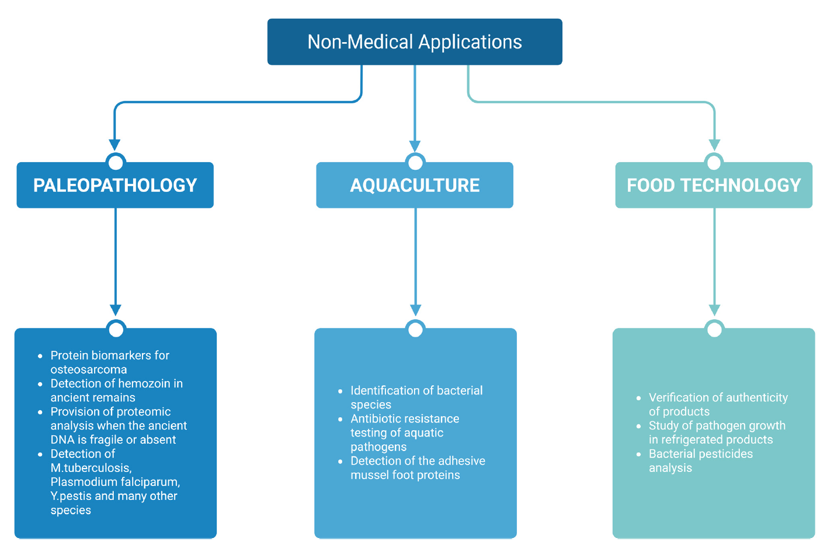
Non-medical applications of MALDI-TOF MS
Anna Andreadi and et al, Open Life Sciences 2025; 20: 20251136

Slide 4
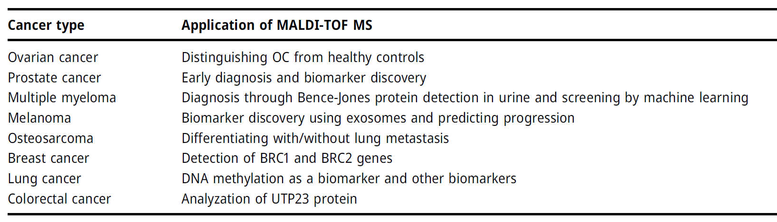
Diagnostic applications of MALDI-TOF MS
Anna Andreadi and et al, Open Life Sciences 2025; 20: 20251136

Slide 5
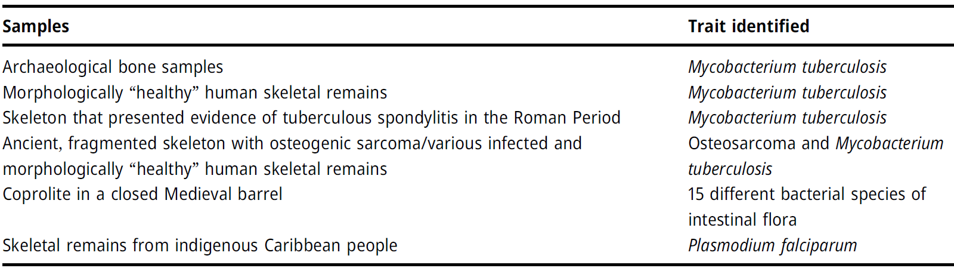
Summary of palaeopathological research with MALDI-TOF MS
Anna Andreadi and et al, Open Life Sciences 2025; 20: 20251136

Slide 6
Although the non-absorbing amino acid alanine as a neat sample was not accessible by LDI, it gave clear signals in the mass spectrum when mixed with the highly absorbing amino acid tryptophan. Tryptophan was acting here as a matrix for the analyte alanine by taking up the energy of the laser pulse and providing for desorption and ionization of both components.
This observation led to the development of the technique of matrix-assisted LDI (MALDI) by using a standard highly-absorbing material in a considerable excess to the analyte under investigation.

Slide 7
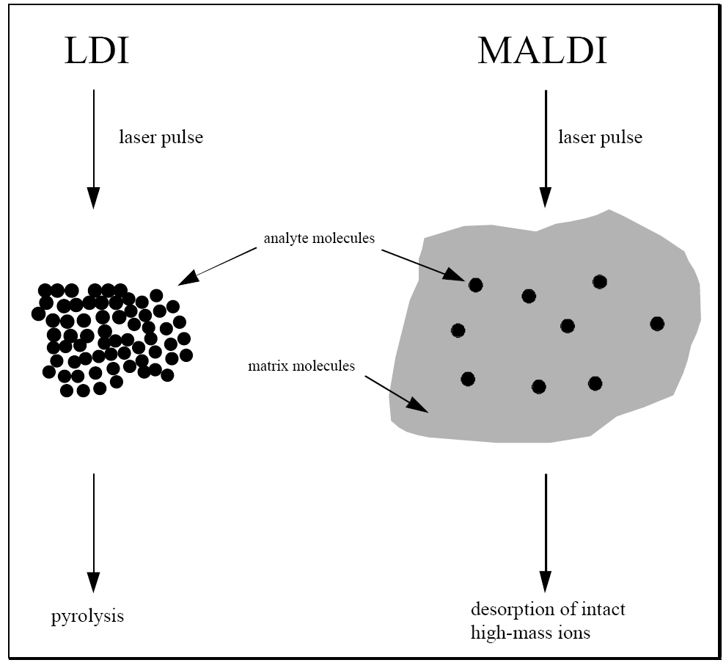
Principle of Matrix-assisted Laser Desorption Ionization (MALDI).
1. As laser energy absorbent and for energy transport.
2. The matrix also separates the analyte molecules from each other, preventing cluster formation and
3. Avoiding direct laser “hits” on the analyte that would lead to intense fragmentation.

Slide 8
A useful matrix is believed to provide a number of different essential functions:
The first is to isolate analyte molecules by dilution within the preparation, to prevent analyte aggregation.
Second, the matrix has to absorb the laser energy via electronic [ultraviolet (UV-) MALDI] or vibrational [infrared (IR-) MALDI] excitation.
Third, disintegration of the condensed phase has to take place without excessive destructive heating of the embedded analyte molecules.
Last, but not least, an efficient ionization of analyte molecules has to be provided.
Other more technical aspects are a sufficient solubility in a suitable (analyte-compatible) solvent and a sufficient vacuum stability.

Slide 9
Two closely related techniques have, moreover, been developed.
The first is based on the use of suspensions of highly absorbing inorganic “nanoparticles”, e.g., cobalt, silicon, or titanium-nitride with diameters in the low nm to low µm range, in a suitable liquid (typically glycerol).
In comparison to common MALDI with chemical matrixes, laser desorption from particle suspension matrixes is less soft, however, and accompanied by a higher degree of analyte fragmentation. The mass range in which suspension matrixes can be reasonably employed is, therefore, limited to about 10 kDa for peptides/proteins. The limitations result essentially from the different ways compared to MALDI with chemical matrixes-of energy deposition and phase transition, mediated by a heated surface. This is believed to result in a too destructive heating of the analyte molecules and an insufficient desorption rate. “Two-phase matrix-”,“graphite-assisted-”, and “surface-assisted” laser desorption ionization (SALDI) have been introduced as alternative notations for this approach.

Slide 10
Another modification of “surface-MALDI” is the preparation of neat analyte samples on highly porous silicon surfaces. This desorption ionization on silicon (DIOS) technique was introduced by Wei et al. in 1999 and has been shown meaningful for molecules in the low (matrix) mass range.
The upper mass limit of DIOS is in the low kilodalton range. A so far not satisfactorily resolved problem of the technique is a poor reproducibility from chip to chip. Because of the different mechanisms and their minor analytical relevance, compared to conventional MALDI with chemical matrixes, the surface-MALDI approaches will not be further addressed.

Slide 11
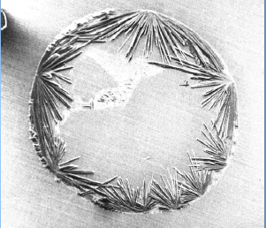
Analyte Incorporation
In a typical UV-MALDI sample preparation small volumes of an about 10⁻⁶ M solution of the analyte and a near-saturated (ca. 0.1 M) solution of the matrix are mixed; the solvent is then evaporated before the sample can be introduced into the vacuum of the mass spectrometer.
solved Matrix
solved sample
Mixing and Drying

Slide 12
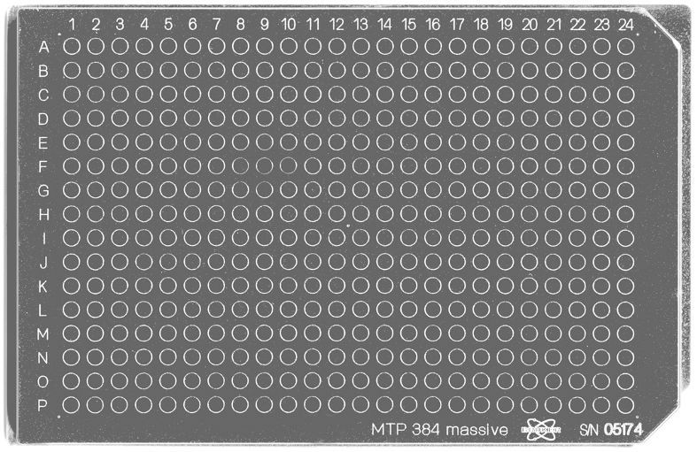
Typical MALDI target. The Bruker Scout384™ target offers a 16 × 24 spot array with 384 positions for sample preparation. Here, a standard nickel-coated massive aluminum version is shown; its dimensions are 84 × 128 mm with marks of 3 mm in diameter.

Slide 13
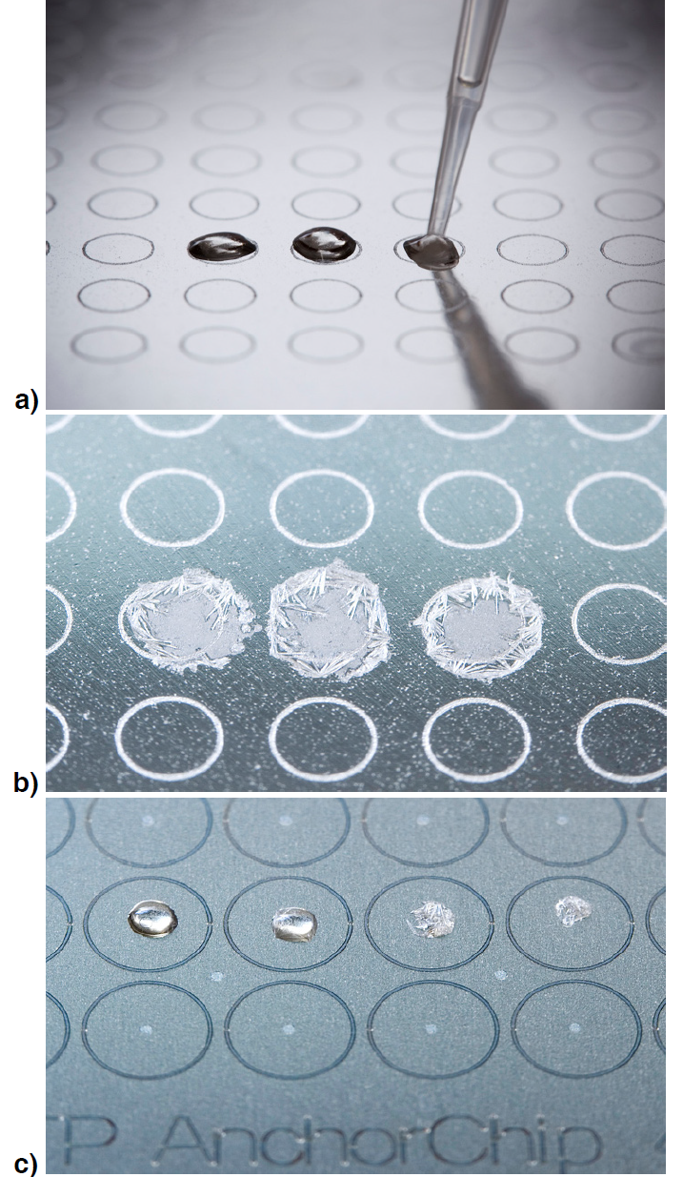
Sample preparation for MALDI. (a) Pipetting of 1 μl of sample–matrix solution onto a standard MALDI target; (b) same spots after DHB has crystallized show large crystals on the rim and evenly distributed small crystals in the center; (c) cummulative effect of hydrophilic spots (bright areas in circles) present on a hydrophobic surface of an Anchor-Chip™ target on crystallizing DHB matrix.

Slide 14
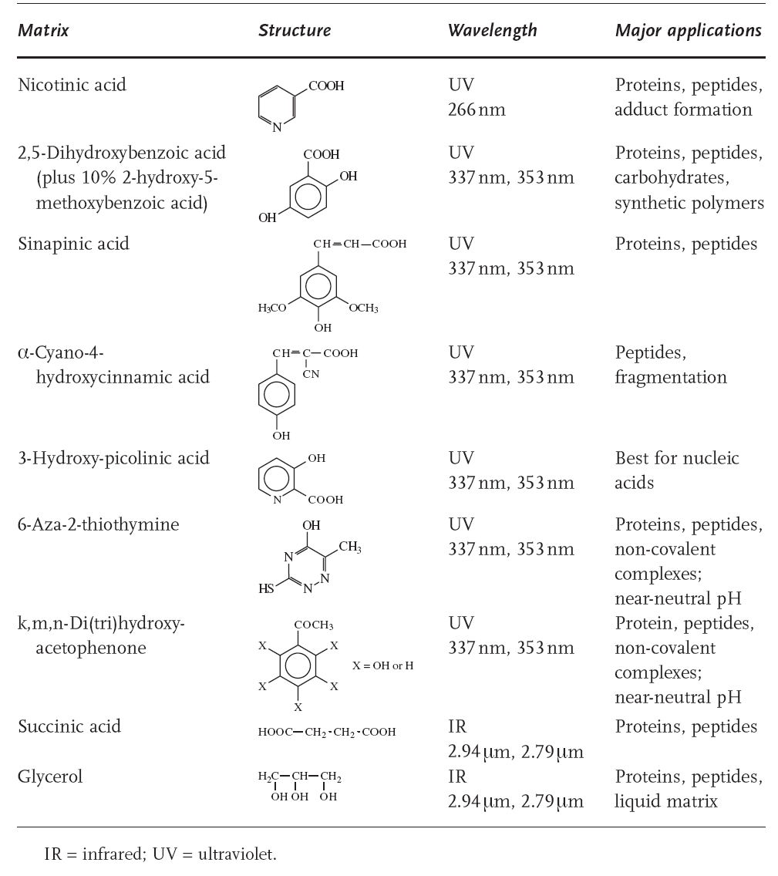
1. Absorption
H = H_{o} e ^{-αz}
H: Laser fluence at depth z into the sample
H_{o}: Laser fluence at the sample surface
α: The absorption coefficient

Slide 15
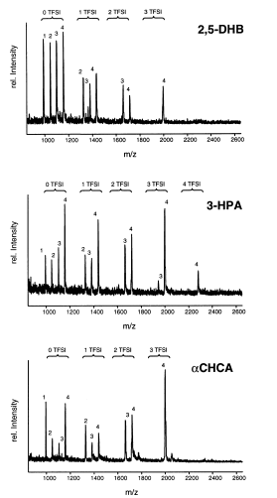
Positive mass spectra of a peptide mixture obtained with different matrixes and addition of HTFSI (bis(trifluoromethylsulfonyl)imide). (2,5-DHB ) 2,5-dihydroxybenzoic acid, 3-HPA ) 3-hydroxypicolinic acid, RCHCA) hydroxy-R-cyanocinnamic acid.
Chem. Rev. 2003, 103, 427−439

Slide 16
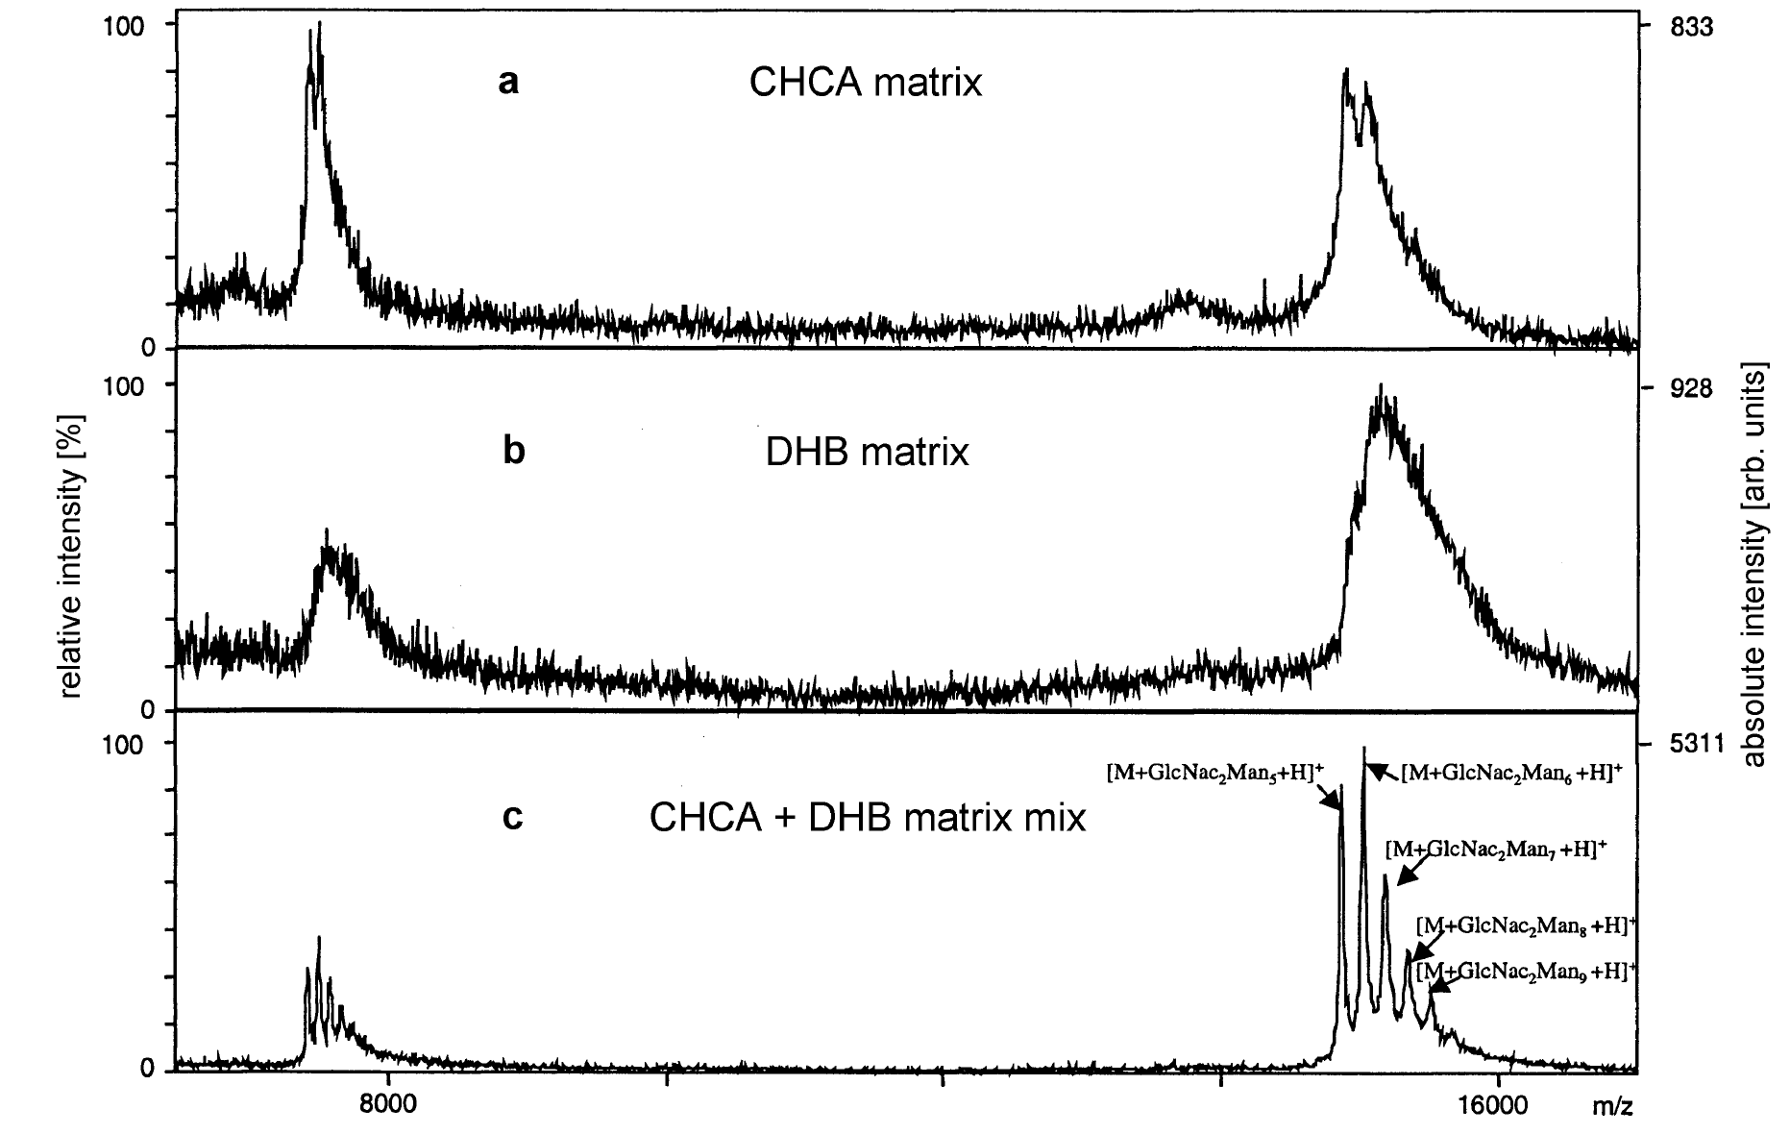
Linear mode positive-ion MALDI-TOF spectra of ribonuclease B in 80 mM urea. a) 300 fmol in CHCA, (b) 600 fmol in DHB, and (c) 300 fmol in CHCA/DHB matrix mix.

Slide 17
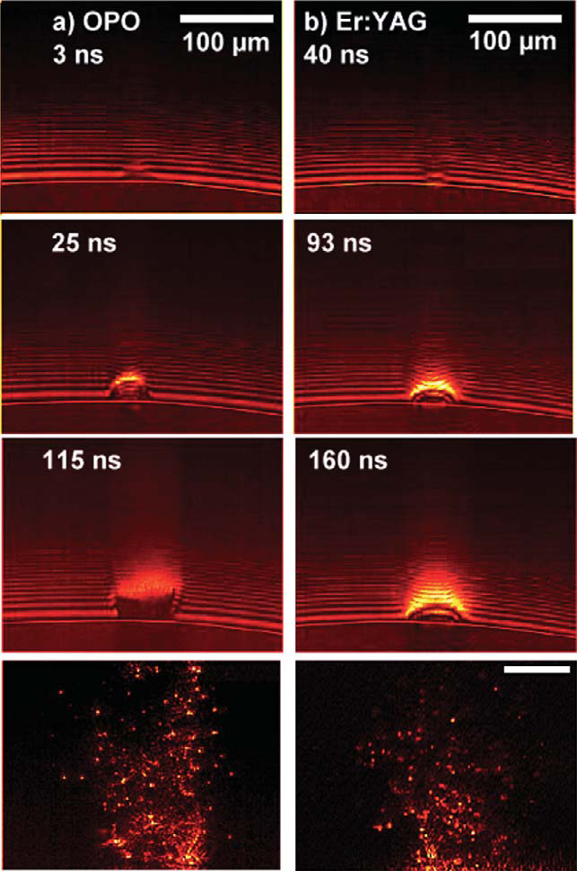
High-speed time-lapse photographs of IR-MALDI plumes generated with an optical parametric oscillator (OPO) laser with 6-ns pulse width and an Er:Yag-laser with 100-ns pulse width. Both lasers were operated at 2.94 μm wavelength. Matrix: glycerol; time resolution 8 ns; spatial resolution 4 μm.
In IR-MALDI (ER:YAG-laser), the absorbing volume is superheated to a temperature that is substantially above the boiling temperature, followed by a volume ejection of material through boiling by heterogeneous nucleation.
The longer time course of material ejection in the IR as compared to the UV is caused by a deeper penetration of the radiation into the sample.
The ablated mass per laser exposure in IR-MALDI exceeds that of UV-MALDI by at least a factor of 10, and the sample consumption rate is accordingly higher.

Slide 18
Problems of MALDI
1. ،he suppression effects between analyte molecules still frequently arise during MALDI analysis, especially in the analysis of the mixtures (for analysis of trace compounds).
2. The presence of sodium and potassium in the sample solution, cation adduct clusters are commonly detected in MALDI-MS spectra;
3. The serious background arising from organic matrix ions also makes characterization of small molecules (<500 Da) difficult. Inconvenience in detecting small biomolecules due to the interference of ions produced by matrix molecules. Direct ionization on silicon (DIOS) and direct ionization on metal (DIOM
4. Contaminants like buffers, salts and detergents brought in by the samples are an important factor influencing the results in MALDI MS.
5. A strong variation in intensity and resolution of the signals at different positions of a sample. This so-called hot spot or sweet spot formation leads to poor reproducibility.
6. The mass resolution for a MALDI linear TOF mass spectrometer can reach to ∼2000. The mass resolution of a reﬂectron TOF mass spectrometer can be higher than 10,000. Nevertheless, a reﬂectron TOF mass spectrometer is difﬁcult to apply to molecules with mass-to-charge ratio (m/z) larger than 20,000.

Slide 19
To circumvent these limitations
Explore suitable matrices or matrix additives to improve the sensitivity of MALDI detection.
2. The develop proper sample-pretreatment methods to remove sample contaminants and to enrich trace analytes;
3. Using internal standard.
4. However, good results were obtained with the method called surface-activated laser desorption ionization (SALDI) which uses graphite as the surface. But the use of porous silicon as a new surface is more promising and has led to the development of a new method called desorption ionization on silicon (DIOS). Unlike the other matrix-free laser desorption ionization methods, DIOS allows ion formation from analyte with little or no degradation. DIOS allows the analyte molecules to be retained in porous silica and ionization of the sample under UV laser irradiation without using a organic matrix. DIOS mass spectra do not present interference in the low-mass range, while signals due to the matrix are observed in MALDI. The deposition of the sample in aqueous solution is uniform and the preparation of the sample is simplified. Furthermore, DIOS is equivalent to MALDI in sensitivity, but is more tolerant of the presence of salts or buffers.
C.Pan, et al. Anal Bioanal Chem (2007) 387:193–204

Slide 20
MALDI MS Instrumentation

Slide 21
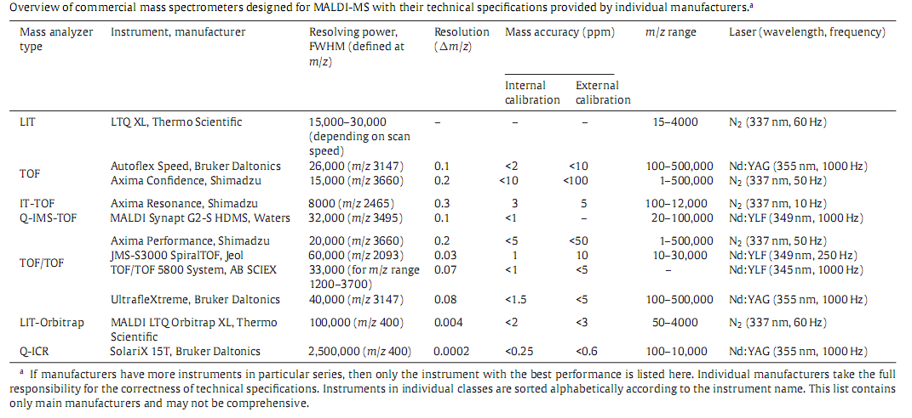

MALDI contrast to electrospray
Advantage
MALDI ions carry only a few charges with the singly charged ions generally predominant.
In principle an unlimited mass range.
Disadvantage
High initial axial velocity
Broad kinetic energy

Slide 22
Fragmentation of MALDI Ions
Ions absorb some of the laser energy directly and are also heated by collisions with the matrix molecules which absorb the laser light very efficiently. For MALDI, because the ions are generally metastable, a “Pseudo-MS/MS” technique exists where the parent ions are fragmented, but isolation of the precursor is not performed. This method is often (and incorrectly) called tandem mass spectrometry, but is correctly called simply metastable decay and, in TOF instruments, can be classified as either “in-source” decay or “post-source” decay.
An electric field in the source will accelerate the ions and drag them through the matrix plume, causing collisional activation. A few millibars of inert gases such as He, Ar, or N2 in the ion source, can cool the ions and thereby increase their stability. If the MALDI ions collide with these thermal gas molecules, some of their vibrational energy gets removed. Without cooling, the ions could barely be detected.
Chemical reactions such as hydrogen and proton transfer occur inside the plume and have certain exothermicities associated with them.
Metastable decay

Slide 23
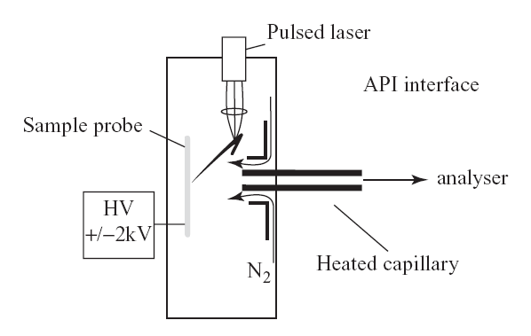
Atmospheric Pressure MALDI (AP-MALDI)

Slide 24
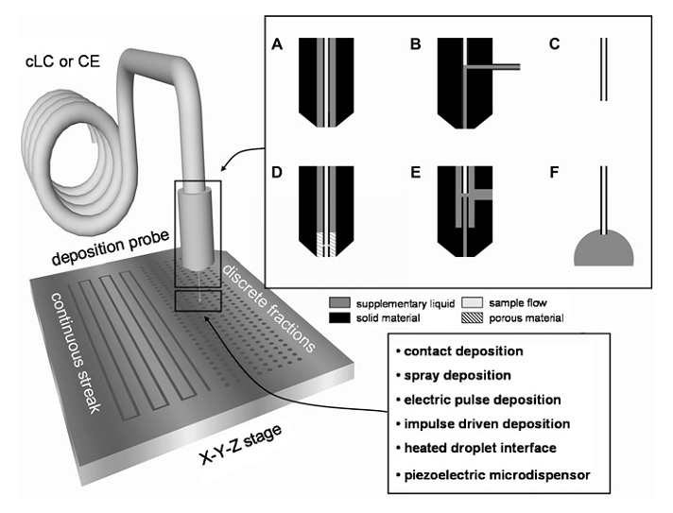
Scheme of off-line LC–MALDI-MS coupling with the supplementary liquid addition and deposition mechanisms. Junctions used for coupling of microcolumn techniques include the following: (A) coaxial sheath ﬂow, (B) T-junction, (C) sheathless interface, (D) porous junction, (E) liquid junction, and (F) droplet electrocoupling. A, B and C are typical for capillary LC–MS, while D, E and F are common in capillary zone electrophoresis–MS

Slide 25
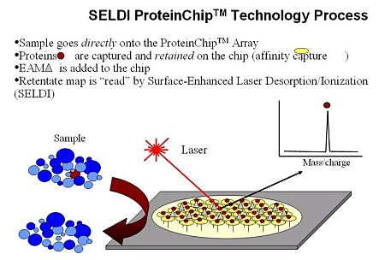

Slide 26
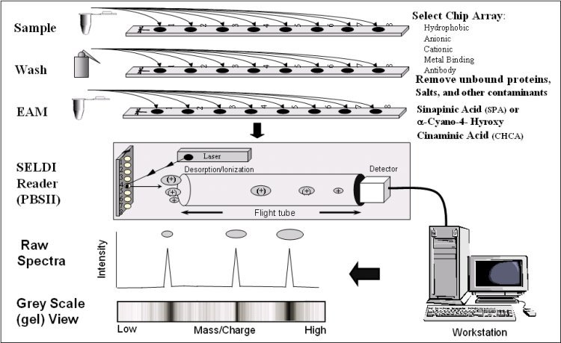
SELDI Process

Slide 27
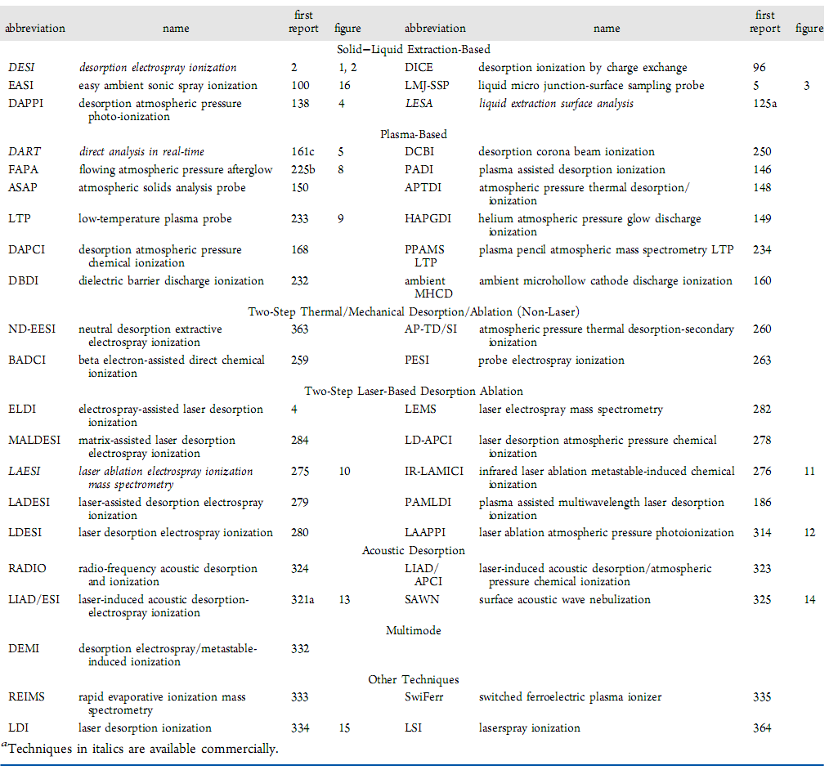
List of Ambient MS Techniques
Chem. Rev. 2013, 113, 2269−2308

Slide 28
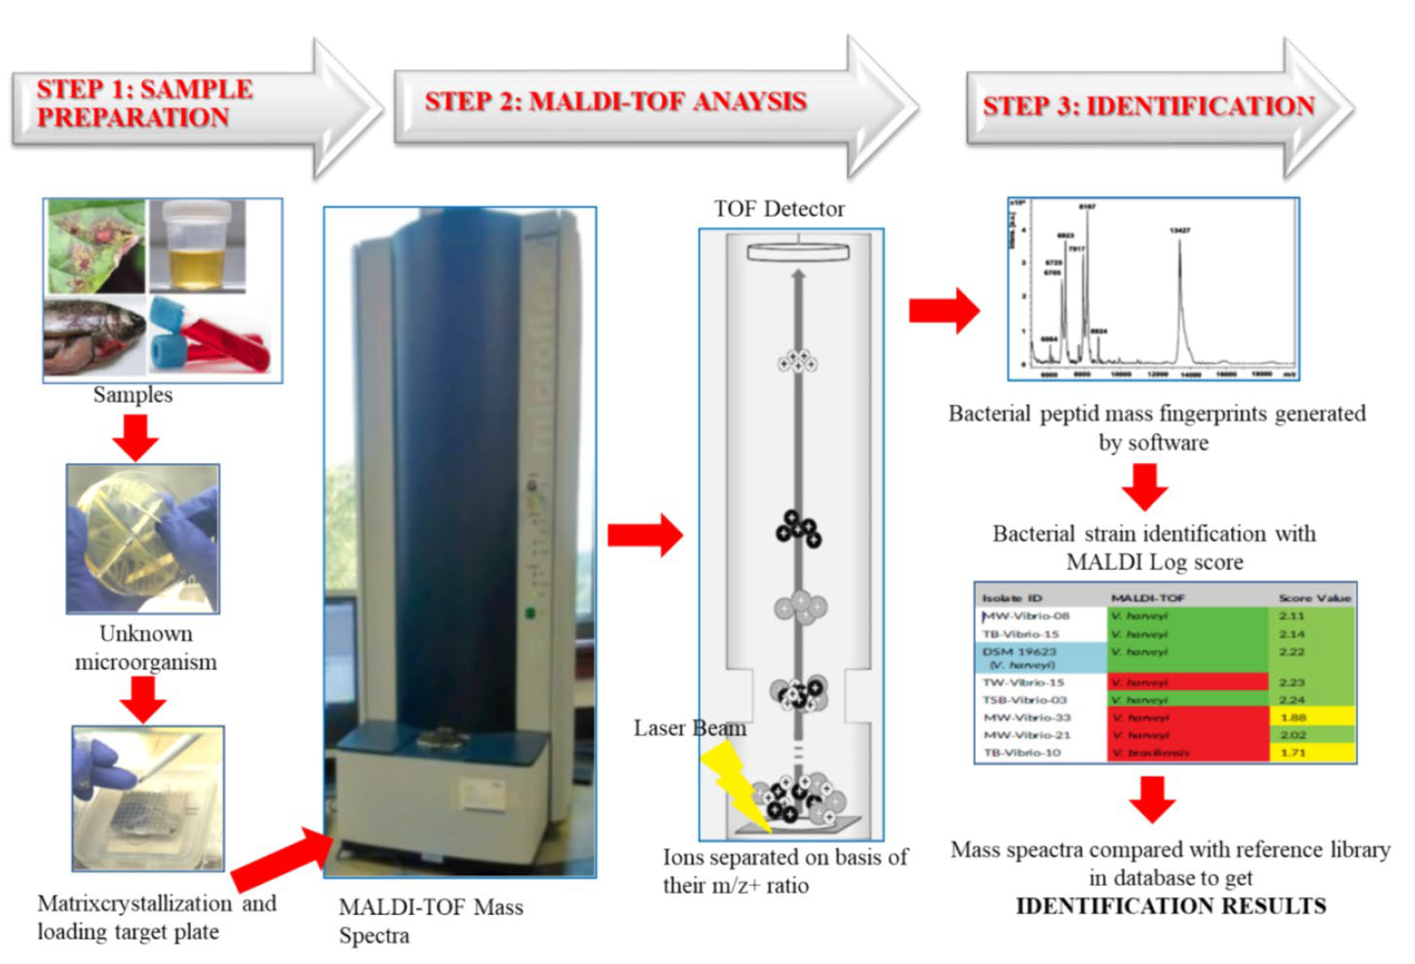
Schematic steps for MALDI-TOF MS bacterial identification, STEP 1. Sample preparation, STEP 2. MALDI-TOF MS analysis in instrument, STEP 3. Identification of bacteria using the database
İfakat Tülay Çağatay1Aquaculture International (2024) 32:7835–7871

Slide 29
Examples of the distinctive MALDI‐TOF‐MS profiles of intact cells of Porphyromonas sp. containing both genus‐specific (e.g. 618 and 844 Da mass ions) and also a significant number of species‐specific mass ions (examples indicated by arrows). Members of the genus Porphyromoas now comprise 18 species, in addition to several others that have not yet been validated (Bergey’s manual, 2011). However, with the exception of DNA/DNA reassociation, they could not be reliably delineated at the time. The three representative MALDI‐TOF‐MS spectra shown and those reported earlier (Shah et al., 2002) revealed that each species could be unambiguously distinguished.

Slide 30
We carried out thorough investigations on the safety aspects of the procedures and produced a detailed application note for MALDI-TOF. To verify this, tough resistant spore‐formers, Bacillus stearothermophilus (NCTC 10003) and Bacillus subtilis (NCTC 10073), which are industry standard controls for heat and chemical sterilization, were processed through the instrument at various concentrations and samples collected at potential leakage points within the instrument and vacuum pumps. No growth was observed in any sample, and this, together with other successful safety tests, led to the Health and Safety Executive granting approval for the use of MALDI‐TOF MS in a clinical laboratory and permission for engineers to carry out repairs in situ when necessary.
However, in spite of careful assessment of the risk, one major accident occurred in the laboratory in 2000 that nearly terminated all future work at PHLS.
The standard method used for cleaning target plates at the time was sonicating for half‐hour intervals in methanol followed by washing in 33% (w/v) aqueous nitric acid, and final rinsing in distilled water (e.g. Evason et al., 2001). If the methanol and nitric acid are mixed and kept in a sealed container, the reaction is explosive.

Slide 31
Changes in the MALDI‐TOF‐MS profile of the same strain of Porphyromonas catoniae (NCTC 12856) grown of Fastidious Anaerobic Agar (FAA) and Columbia Blood Agar (CBA). Many of the significant mass ions, e.g. 542, 580, 618, 689, 784 and 845 Da, are retained. However, significant mass ions such as 935 Da are present only in cells grown on CBA.
5‐chloro‐2‐mercaptobenzothiazole (CMBT) is suitable for gram‐positive and α‐Cyano for gram‐negative bacteria.

Slide 32
Identification of clinical isolates received by MISU using 16S rRNA and MALDI‐TOF MS (Micromass, UK) over a 10‐year period. MISU receives atypical, rarely isolated and emerging pathogens, and for such unusual isolates, the results shows that MALDI‐TOF MS was significantly more useful in identifying these isolates to the species level.

Slide 33
Some of the most popular types of ProteinChip arrays (H50, Q10, CM10 and NP20) used for analysis of microbial cells extracts and an overview of the process to obtain a mass spectral profile. From left to right, the sample is added to the ProteinChip array, the wells washed and air‐dried for a few minutes, the matrix (Sinapinic acid) added, followed by mass spectral analysis to yield the spectra shown.

Slide 34
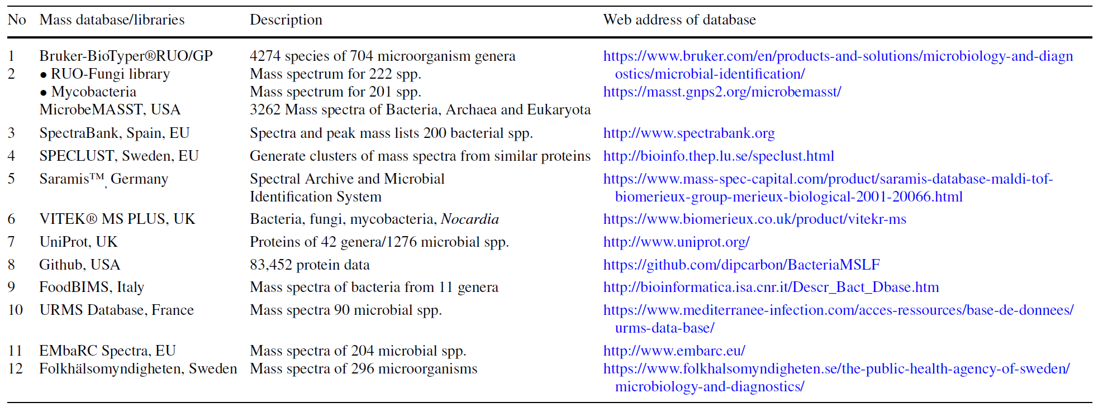
MALDI-TOF MS databases and libraries globally
İfakat Tülay Çağatay1Aquaculture International (2024) 32:7835–7871

Slide 35
Application of MALDI‐TOF MS in Clinical Virology
The first approach is the detection of biomarker viral proteins from infected cell cultures. Using this strategy, Calderaro et al. reported the detection of Picornaviridae from infected cell culture using the viral protein VP4 as a biomarker [97]. La Scola et al. demonstrated that giant viruses (capsid sizes of 150 to 600 nm) could be characterized using MALDI‐TOF MS analysis of viral particles. The results obtained correlated with results provided by the sequencing of the polB gene [98]. However, this method requires specific equipment and is time consuming (cell lysis, filtration, concentration by centrifugation, rinsing, ultracentrifugation), which makes routine use difficult. Another approach applied for influenza viruses detection consisted in the capture of viral particles using magnetic nanoparticles functionalized with H5N2 specific antibodies with subsequent MALDI‐TOF MS analysis of the complexes nanoparticles/viruses to detect the hemmaglutannin protein HA [99]. This allowed H5N2 detection with no cross reactivity with H5N1 viruses.

Slide 36
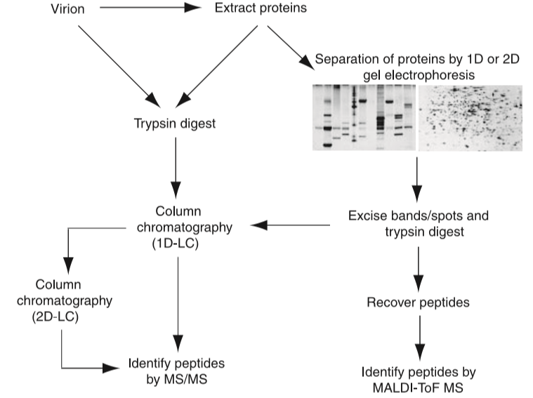

Slide 37
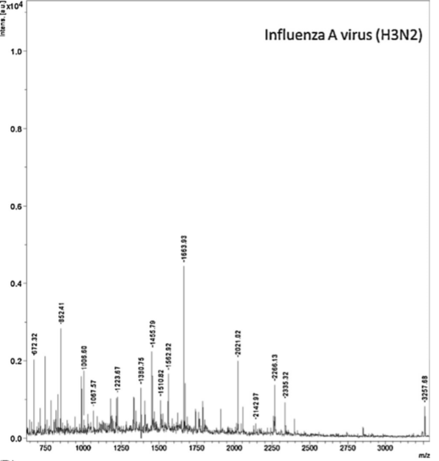
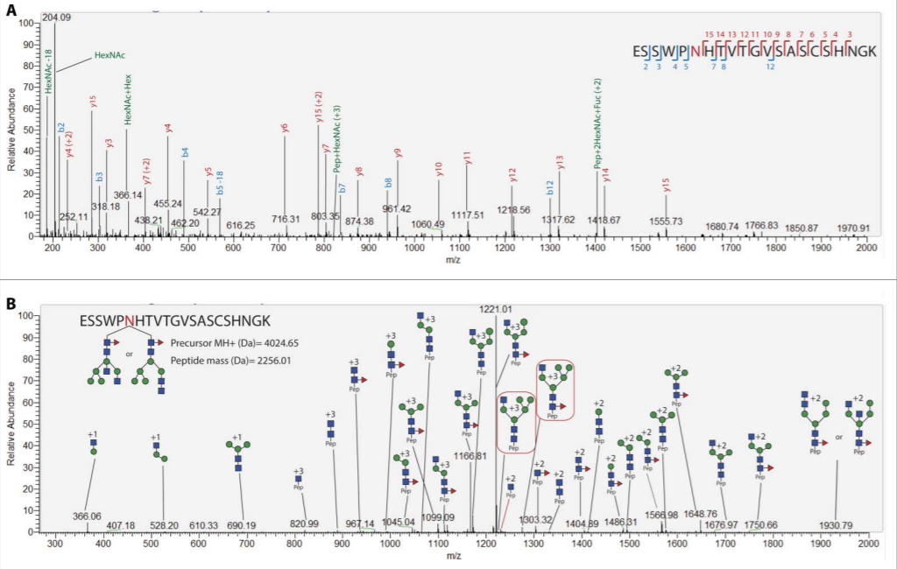
Majchrzykiewicz-Koehorst JA, Heikens E, Trip H, Hulst AG, de Jong AL, Viveen MC, Sedee NJ, van der Plas J, Coenjaerts FE, Paauw A. Rapid and generic identification of influenza A and other respiratory viruses with mass spectrometry. J Virol Methods. 2015 Mar;213:75-83. doi: 10.1016/j.jviromet.2014.
Cruz, E., Cain, J., et al. 2018. Site- specific glycosylation profile of influenza A (H1N1) hemagglutinin through tandem mass spectrometry. Hum. Vaccin. Immunother . 14,508-517.

Slide 38
PTM

Slide 39
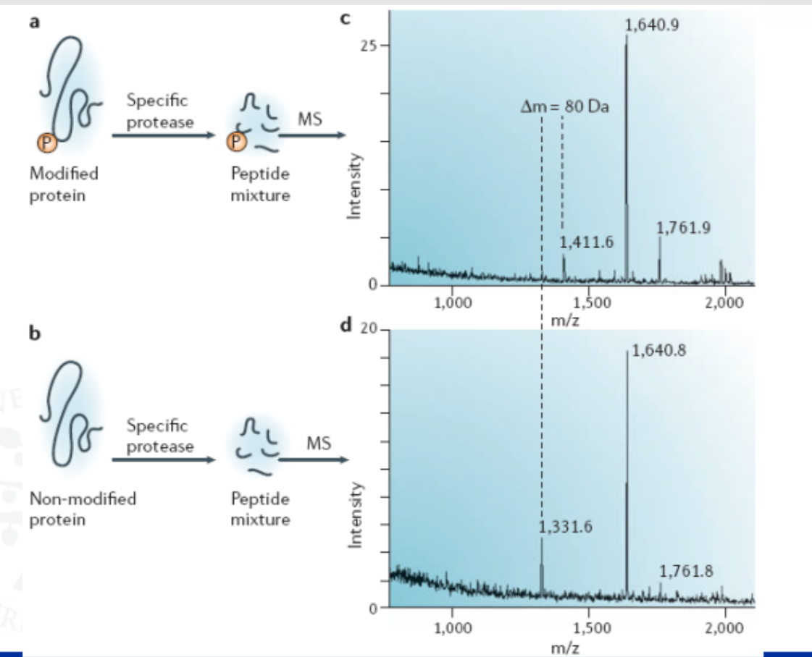

Slide 40
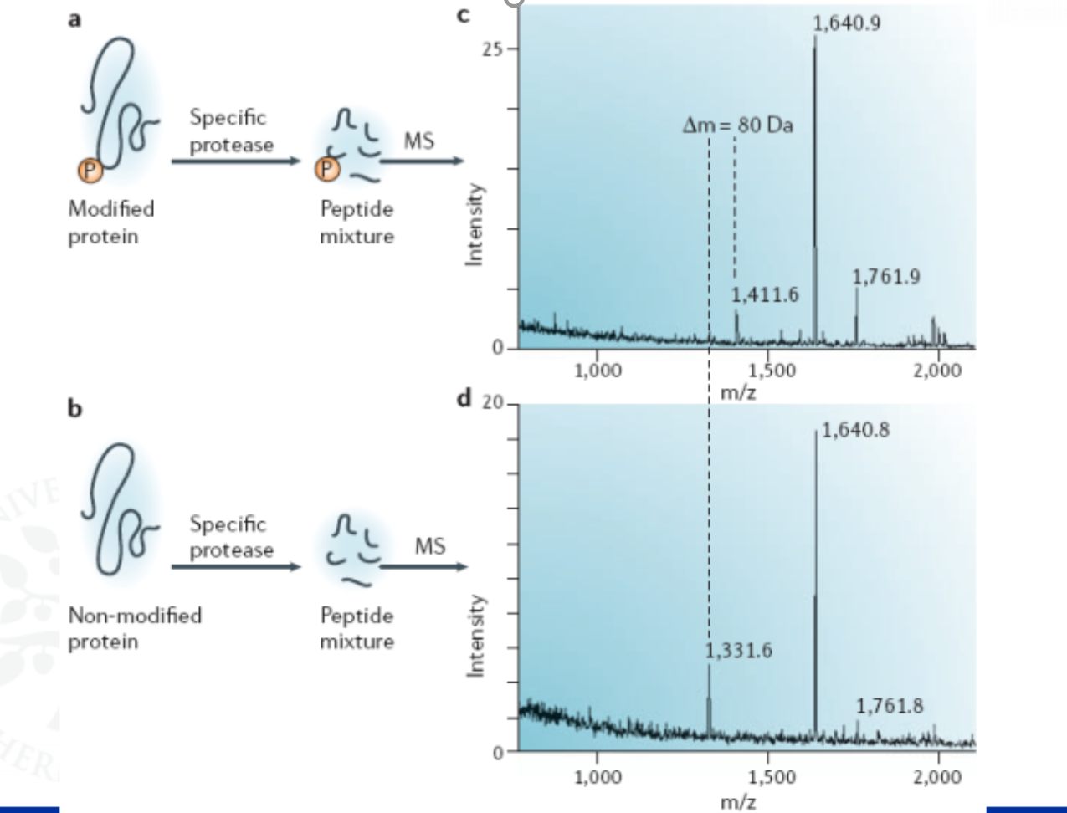

Slide 41
Imaging MS

Slide 42
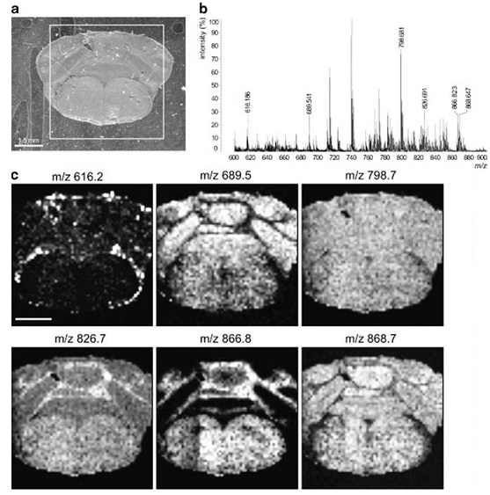
Characteristic lipid distribution in a rodent brain.

Slide 43
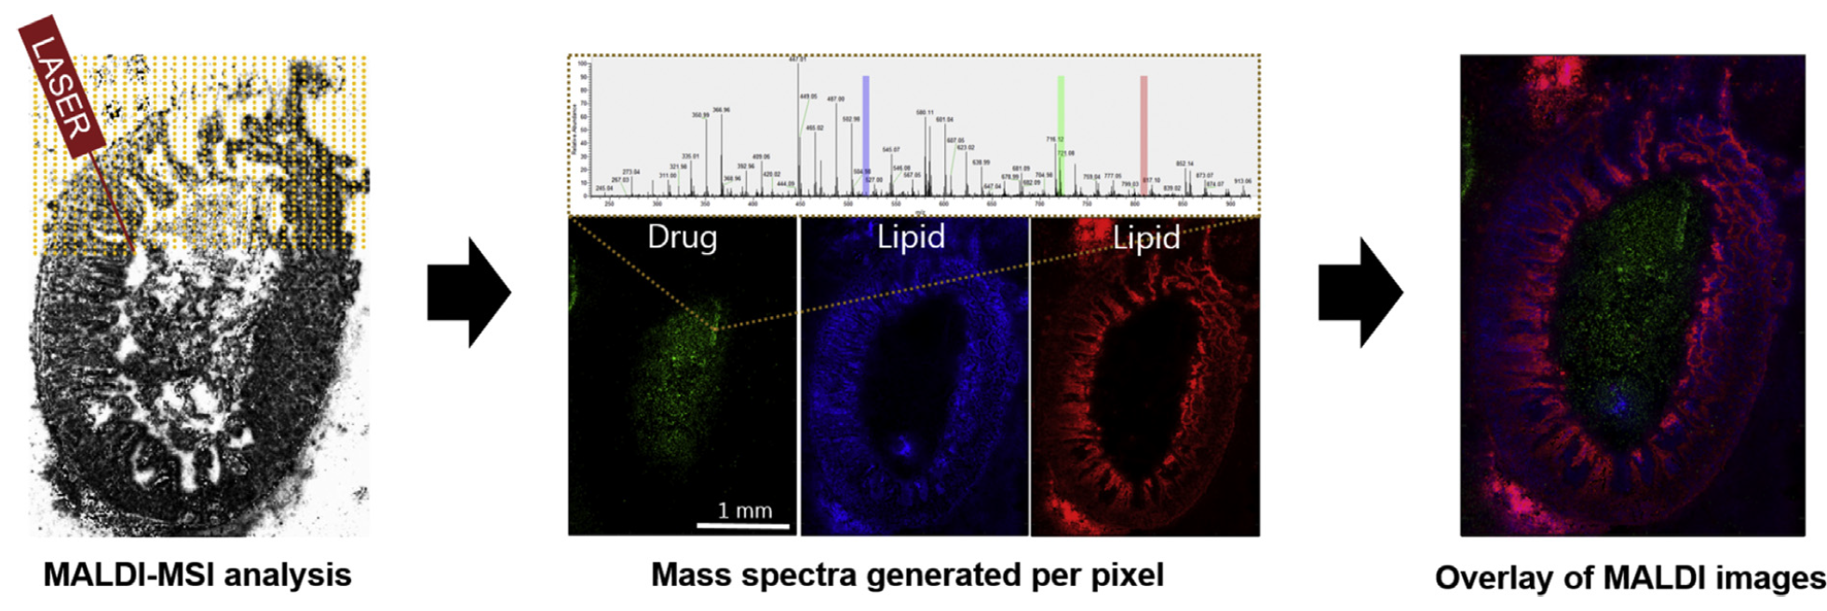
Analysis with MALDI MSI. Left: Illustration of laser ablation pattern during MALDI-MSI experiment. Middle: MS images illustrating how each pixel represents an entire mass spectrum. Shown here is the distribution of two endogenous lipids and a drug in small intestine from a rat (green: Posaconazole [M-H2O + K]+, Blue: LysoPC 16:0 [MþK]þ, Red: PC 36:2 [M+K]+. Right: Overlay of drug and lipid images showing the drug is distributed in the lumen of the rat intestine and the lipids illuminating different structures of the small intestine.
Subsequently, extracted ion images may be generated for any detected ion where the intensity of the ion is plotted as a function of position e the higher the intensity, the more intense the color.
J.R. Granborg, A.M. Handler and C. Janfelt, Trends in Analytical Chemistry 146 (2022) 116482.

Slide 44

Thank you for your attention

