Slide 1
Liquid Chromatography-Electrospray and Nanospray

Slide 2
Sample Treatment
Solid phase microextraction,
Microextraction by packed sorbents,
3D-printed sorbents,
Molecularly imprinted polymers,
Magnetic nanoparticles,
Magnetic ionic liquid-based liquid-liquid microextraction,
Dispersive liquid-liquid microextraction,
Nanoconfined liquid phase nanoextraction,
Supported liquid membrane-electromembrane extraction
etc.

Slide 3
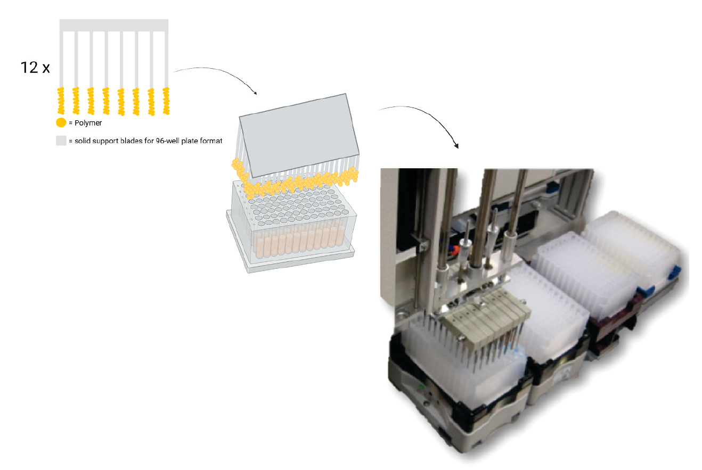
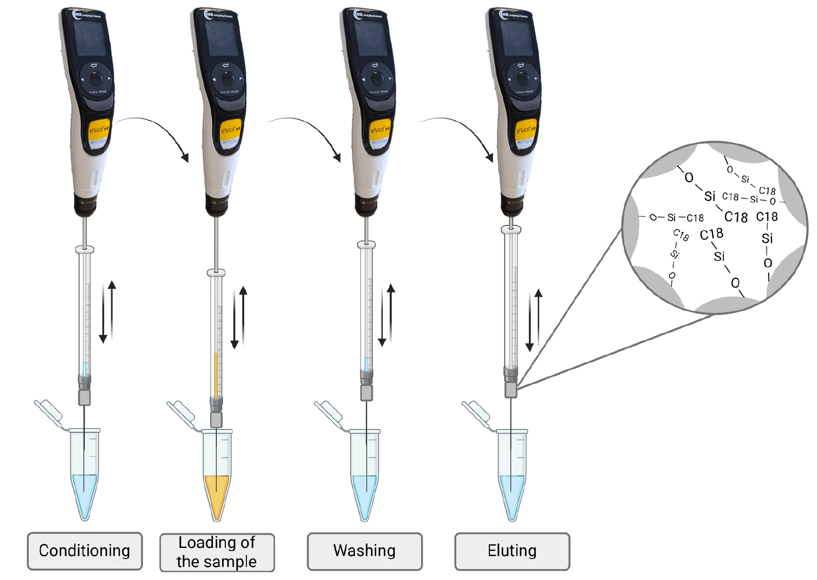
Schematic representation of TF-SPME blades for 96-well plate format; edited .
P. Verding et al., J o u r n a l o f P h a r m a c e u t i c a l a n d B i o m e d i c a l A n a l y s i s 268 (2026) 117202

Slide 4
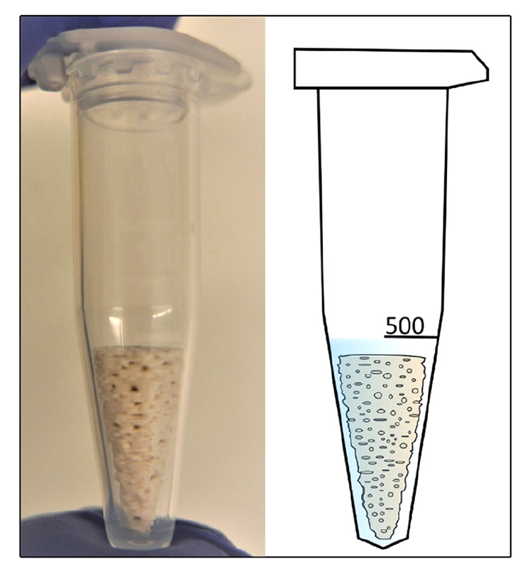
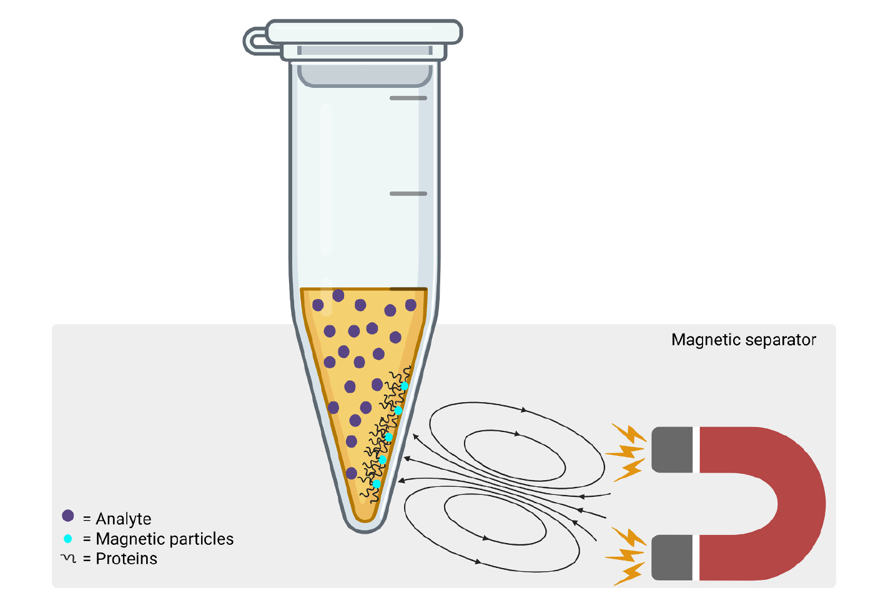
3D-printed sorbent device placed in a 1.5 mL test tube. Image licensed
under the “Creative Commons Attribution 4.0 International”
Schematic representation of magnetic nanoparticles, created in BioRender

Slide 5
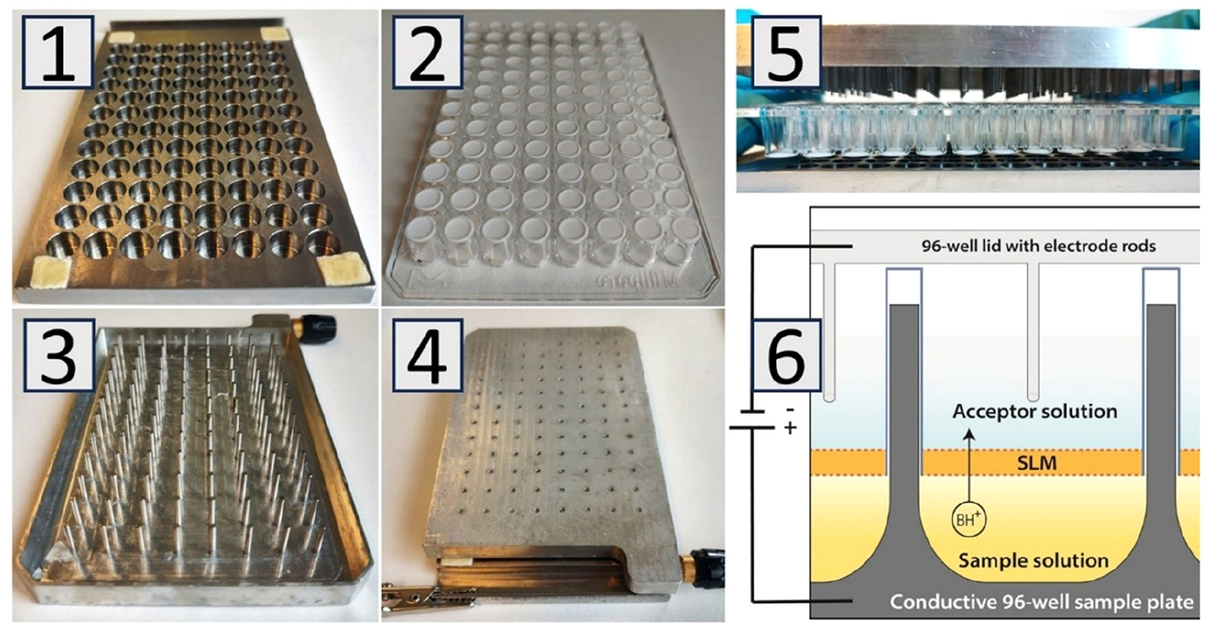
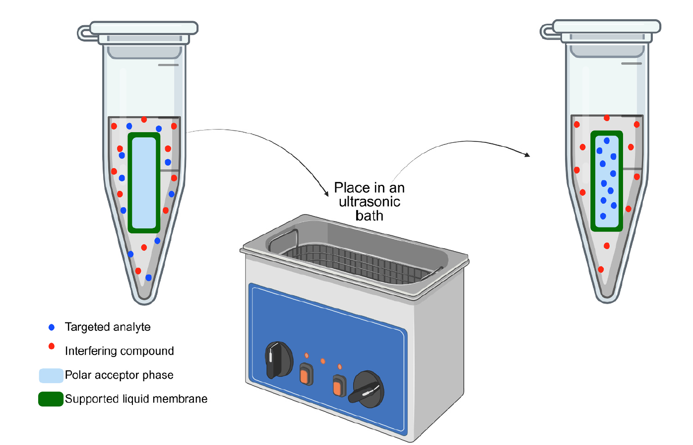
The 96-well supported liquid membrane-electro membrane extraction (SLM-EME) device. 1: Donor plate. 2: Filter plate for acceptor solutions. 3: Aluminum lid of electrode rods. 4: The donor plate, filter plate, aluminum lid assembled. 5: Horizontal view of 1–3. 6:
Schematic representation of ultrasound-assisted hollow fiber liquid phase microextraction (UA-HF-LPME),

Slide 6
High Performance Liquid Chromatography-Mass Spectrometry (LC-MS)

Slide 7
J. Chaudhary, et al., J. Liquid Chromatogr. & Re. Tech, 48:11-15, 191-201, 2025.

Slide 8
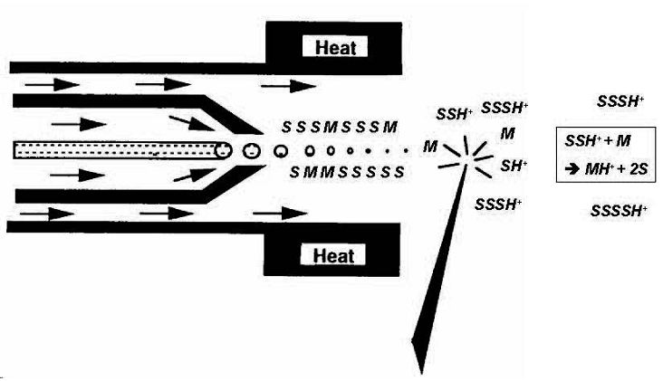
ESI:
An electrospray needle at high electric potential
A means for establishing an electric potential difference between
Spray needle and the orifice into the high vacuum region
An optional desolvation apparatus (usually thermal or pneumatic)
APCI:
A spray needle
A thermal desolvation chamber
A corona discharge needle interact with both the nitrogen nebulizing gas and the vaporized HPLC solvent to produce a corona of ions formed through direct ionization. Though nitrogen is the principal gas in the APCI chamber, nitrogen ions feed into a cascade of ion/molecule reactions in which water molecules (usually part of the mobile phase) capture a proton and react with additional water molecules to form a high flux of protonated clusters of water molecules.

Slide 9
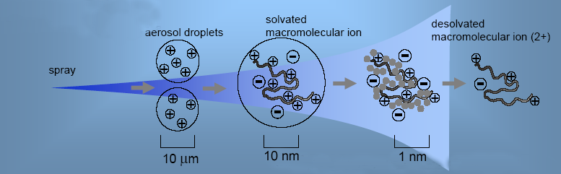
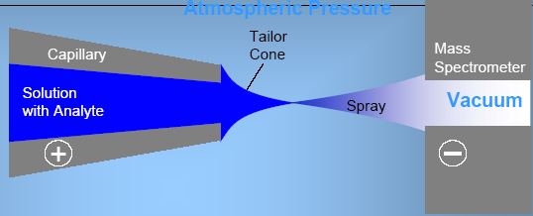
The positive charges at the surface repel each other, and the liquid surface expands away from the needle tip. When the electrostatic force and the surface tension are balanced, the cone-shaped liquid surface has a half-angle of 49.3° at the apex. This is referred to as a “Taylor cone” following the work of G. Taylor. As the droplet grows small, the potential increases, the excess positive charge overcomes the surface tension, and droplet formation occurs from the tip of the Taylor cone.

Slide 10
Axial configuration of ESI
The orifice is no longer saturated by solvent. Instead, only ions are directed towards the inlet thus orifices can be larger than in the axial configuration.
The combination of larger orifices and noise reduction largely compensates for transmission losses due to the orthogonal geometry, giving a large gain in sensitivity.
The flow rates can be increased.
This configuration gives better protection of the orifice against contamination or clogging, giving a gain in robustness.
The orthogonal configuration with indirect trajectory of analyte ions also introduces unwanted discrimination based on mass or charge.

Slide 11
Optimization for normal ESI (cone-jet spray) can be difficult with gradient chromatography because mobile phase characteristics such as surface tension, viscosity and flow rate change. One set of ESI tuning conditions is unlikely to yield a stable spray mode throughout an LC gradient.
The resulting spray instabilities can shift charge state distribution and increase the relative standard deviation of ion current.

Slide 12



Multiply Charged Ions
Consider a positive ion with charge z₁ whose mass-to-charge ratio is measured as being m₁ Th, issued from a molecular ion with mass MDa to which z₁ protons have been added. m=M/z Really, we can see m₁ in mass spectrum which equal to M/z₁ + m_{p} thus
An ion separated from the first one by (j−1) peaks, in increasing order of mass-to-charge ratio, has a measured ratio of m₂ Th and a number of charges z₁ – j, so that

Slide 13
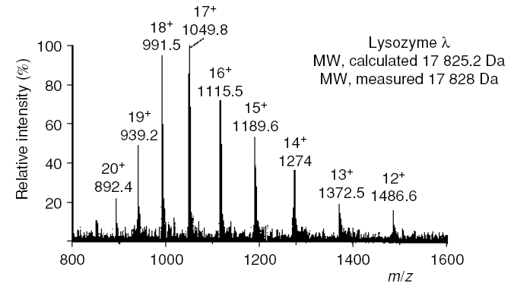
In this example, using the peaks at m/z 939.2 and 1372.5 (j=6),
obtain z1 =6(1372.5−1.0073)/(1372.5−939.2)=19

Slide 14
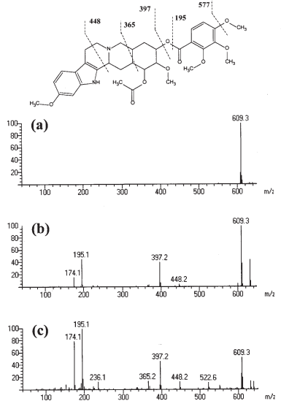
In-source CID. Effect of changing vacuum interface potentials on the ESI mass spectrum of reserpine. The potential difference between orifice 1 and the ring lens is increased from (a) to (b) to (c).
B.N. Pramanik, A.K.Ganguly, M.L. Gross,
Applied Electrospray,

Slide 15
Heating
If the temperature of the desolvating chamber is kept to a reasonable value (e.g., 200°C), the heat achieves desolvation without inducing decomposition of the analyte.
Therefore, many “fragile” species such as thermally labile analytes and noncovalently bound complexes can readily be analyzed with an ESI source that makes use of thermal desolvation.
Species that cannot tolerate high temperatures, such as some unstable organometallic complexes, can be analyzed by the “cold ESI” technique developed

Slide 16
Solvents and Buffers
However, this solvent mixture caused protein denaturation and was of limited use for many other compound classes also.
However, in its normal mode of operation, ESI efficiency is limited by the presence of salts–buffers in the milieu, which are often prevalent in samples derived from biological fluids.
Though it is less amenable to coupling with separations techniques, MALDI is more tolerant than ESI to the presence of salts–buffers, and furthermore shows impressive detection limits for species obtained from biological fluids.

Slide 17
Solvents that are commonly used for RP-HPLC, such as water, methanol, and acetonitrile, are compatible with ESI.
Other useful solvents include dichloromethane and dichloromethane–methanol mixtures, dimethyl sulfoxide (DMSO), higher alcohols such as isopropanol and butanol, tetrahydrofuran (THF), acetone, and dimethyl formamide (DMF).
Solvents that do not work well for ESI are hydrocarbons such as hexane, aromatics such a benzene, and other nonpolar solvents such as carbon tetrachloride.
Toluene is not particularly well suited for use as an ESI solvent, but it has been used in some fullerene studies.
Applied Electrospray, B.N. Pramanik, A.K.Ganguly, M.L. Gross

Slide 18
Solvent Purity, Contaminants and Additive
ESI-MS is very sensitive to the presence of contaminants, and solvents should be free of salts and compounds that might contribute to the chemical background or suppress the analyte.
The sodium is probably introduced to the solvents through contact with glassware or glass containers or transfer lines to the ESI source and produce detectable ions such as [M+Na]⁺.
Concentration of such additives is usually low (0.01–0.1% v/v). Working in the positive ion mode, function of proton donor is provided by acids (formic or acetic). Trifluoroacetic acid (TFA) should be avoided as it may cause ion suppression. In case of the negative ion mode, small addition of various bases is applied (the most popular used is NH3aq).

Slide 19
Nanospray

Slide 20
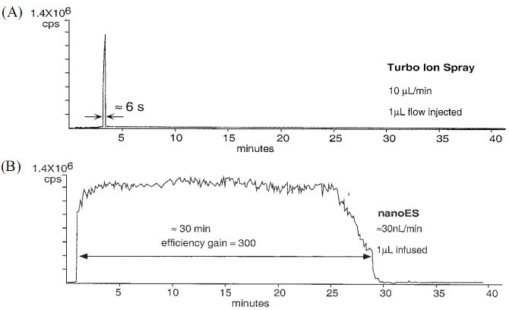
A solution of glufibrinopeptide (0.5 pmol/µL) was used to monitor the doubly charged molecule (selected ion monitoring; SIM). (A) A 1 µL aliquot of solution was injected into a 10 µL/min flow of solvent and ionized with a Turbo IonSpray heated pneumatically assisted electrospray nebulizer with a 50 µm i.d. fused silica capillary emitter. (B) One microliter of the same sample as that used in (A) was deposited into a nanoES tube with a drawn tip of approximately 2 µm exit aperture. Gas pressure of 20 psi was applied, and the sample was electrosprayed at a rate of approximately 30 nL/min until the sample was consumed.
Applied Electrospray, B.N. Pramanik, A.K.Ganguly, M.L. Gross

Slide 21


The condition whereby charge (q) becomes sufficiently large to overcome the surface tension of the liquid (γ) to produce droplets with radius (R) is described by the well-known Rayleigh equation, Eq. (1)
(1)
where (ε₀) is the permittivity of the vacuum. The radius of a droplet produced by electospray also depends upon the fluid flow rate (V_{f}), the permittivity of the solvent (ε), and solution conductivity (κ),
(2)
From this equation it is immediately obvious that smaller droplets are produced by using lower flow rates.

Slide 22
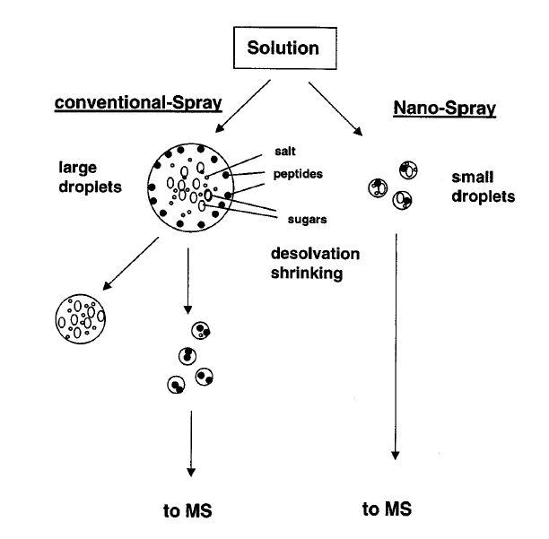

Slide 23
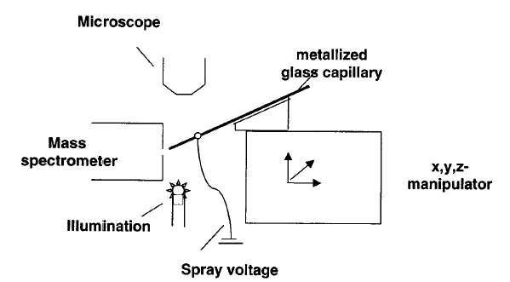
Schematic drawing of a nano-ESI device: the metallized glass capillary is adjusted using a micromanipulator under microscopic control 0.5–2 mm in front of the mass spectrometer orifice. A stable spray is obtained from some mL sample solution in the capillary by applying a voltage of 500–1000 V.

Slide 24
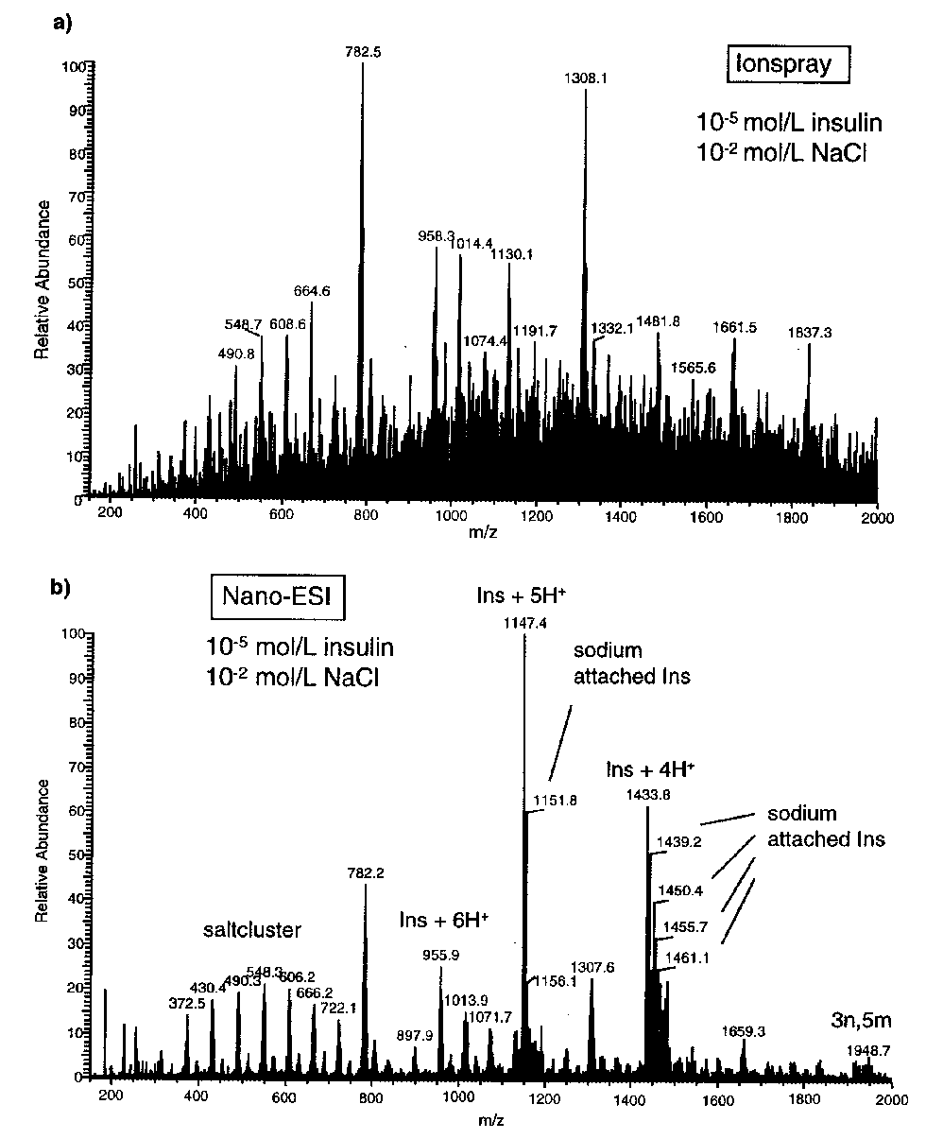

Slide 25
Tandem MS Techniques

Slide 26
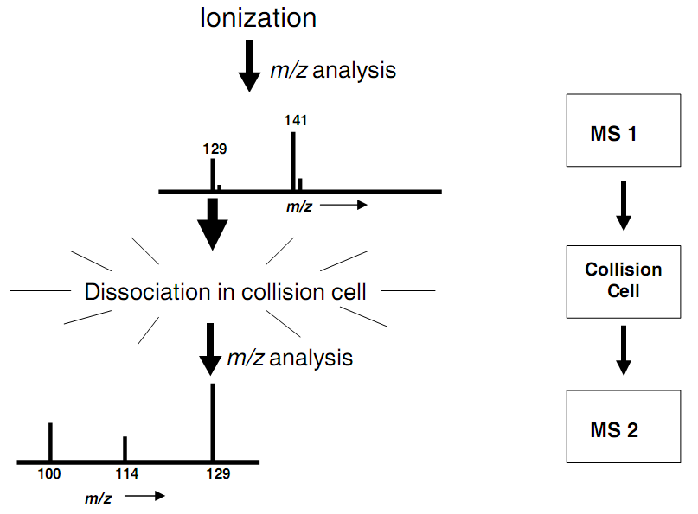
Tandem mass spectrometers
(MS/MS)

Slide 27
Based on the ions will eventually leave the ion source and enter the m/z analyzer, there are three categories of ions in mass spectrometry:
1. stable ions (one microsecond and the half-life of the ion is 3 msec)
2. unstable ions (half-life of the ion is 7 nsec)
3. metastable ions (half-life of the ion is 0.8 µsec).

Slide 28
Apigenin
Apigenin (m/z 271) is a base component of flavonoids
Apigenin has a characteristic fragmentation spectrum
MS^{n} of suspected flavonoids can yield the base component ion m/z 271
Subsequent fragmentation of the m/z 271 ion can verify the compound is a flavonoid

Slide 29
ESI-MS
MH⁺
271.2
100
95
90
85
80
75
70
65
60
Apigenin
55
Relative Abundance
50
MW 270
45
40
35
30
25
20
15
10
5
186.7
210.7
237.0
274.0
358.4
380.3
422.3
479.1
524.0
548.5
0
100
150
200
250
300
350
400
450
500
550
600
m/z

Slide 30
MS²
100
MS/MS of Apigenin
95
153.1
90
85
80
75
70
65
60
55
Relative Abundance
50
45
40
35
243.3
30
25
225.3
20
145.1
271.2
15
10
163.2
203.2
229.1
5
90.9
107.3
118.8
121.2
144.1
173.0
197.1
211.6
253.2
279.8
0
79.8
185.1
219.4
297.0
80
100
120
140
160
180
200
220
240
260
280
300
m/z

Slide 31
ESI-MS
579.1
Suspected Flavonoid
100
95
90
85
80
75
70
65
601.1
60
55
Relative Abundance
50
271.3
45
40
35
30
25
20
602.2
15
518.5
617.5
10
419.5
623.1
5
223.1
263.1
285.3
309.4
345.1
365.2
393.3
433.2
463.4
486.0
516.9
534.8
551.5
645.1
0
200
250
300
350
400
m/z
450
500
550
600
650

Slide 32
MS/MS of m/z 579
271.2
100
95
Unknown
90
85
80
75
70
65
60
55
Relative Abundance
50
45
40
35
432.9
30
25
20
(-147)
15
10
5
161.6
203.2
225.2
270.3
272.2
313.2
337.1
366.8
381.0
417.0
436.5
475.0
497.0
518.3
536.5
561.7
579.3
0
584.2
200
250
300
350
m/z
400
450
500
550
600

Slide 33
MS/MS/MS
271.2
100
579>433>products
95
90
(-147)
(-162)
85
80
Unknown
75
70
65
60
55
Relative Abundance
50
45
40
35
30
25
20
433.0
15
415.1
10
5
215.2
228.9
270.4
271.8
313.3
337.1
367.1
397.1
448.6
517.2
542.5
0
150
200
250
300
350
400
450
500
550
600
m/z

Slide 34
153.1
MS⁴
579>433>271>products
100
95
90
85
80
75
70
65
60
55
Relative Abundance
50
45
40
35
243.3
30
25
225.3
20
145.1
271.2
15
10
163.2
203.2
229.1
5
90.9
107.3
118.8
121.2
144.1
173.0
197.1
211.6
253.2
279.8
0
79.8
185.1
219.4
297.0
80
100
120
140
160
180
200
220
240
260
280
300
m/z

Slide 35
153.1
MS/MS Apigenin
100
95
90
85
80
75
70
65
60
55
Relative Abundance
50
45
40
243.3
35
30
225.3
25
145.1
271.2
20
15
10
118.9
163.2
173.0
203.1
211.6
229.1
5
79.8
90.9
107.3
121.2
144.1
176.8
197.1
253.2
279.8
297.0
0
80
102.4
185.1
219.4
100
120
140
160
180
200
220
240
260
280
300
153.1
m/z
100
MS⁴ m/z 579
95
90
85
80
75
70
65
60
55
Relative Abundance
50
45
40
243.3
35
225.3
30
145.1
25
271.2
20
15
10
118.9
163.2
173.0
203.1
211.6
229.1
5
79.8
90.9
107.3
121.2
144.1
176.8
197.1
253.2
279.8
297.0
0
80
102.4
185.1
219.4
100
120
140
160
180
200
220
240
260
280
300
m/z

Slide 36


Common Methods of Fragmentation
  Collision Induced Dissociation (CID)
    Apply an electric field to accelerate precursor ions and induce bond cleavage via collision with neutral gas molecules.
  Infrared Multiphoton Dissociation (IRMPD)
    Use infrared laser to break bonds
Electron Capture Dissociation (ECD)
  Multiply-charged cations capture electrons, inducing odd-electron fragmentation
  Electron-Transfer Dissociation (ETD)

Slide 37
CID
+
+
Ar
+
+
Accelerated
Precursor Ion
Fragmentation
through one or
more collisions
Product Ions
(And Neutrals)

Slide 38
The CID process has two steps.
The first step is very fast (10⁻¹⁴ to 10⁻¹⁶ s) and corresponds to the collision between the ion and the target when a fraction of the ion translational energy is converted into internal energy, bringing the ion into an excited state.
The second step is the unimolecular decomposition of the activated ion.

Slide 39
IRMPD
+
+
hν
+
Fragmentation
by one or
more photons
+
Isolated
Precursor Ion
Product Ions
(And Neutrals)

Slide 40
ECD
•
+
e⁻
+
+
Capture of one
or more electrons
Product Ions
(And Neutrals)
Isolated
Precursor Ion
The radical cation formed at the time of electron capture readily fragments via a variety of pathways, but favors the formation of c- and z-type ions from proteins. For this reason, the ECD has been of critical important in the development of top-down approaches to protein characterization and identification.
The source of low-energy electrons was originally just a simple heater filament.

Slide 41
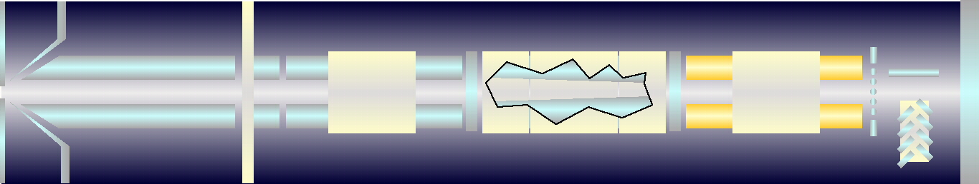

Ion accumulation
Q0
Q1
Q2
Q3
Precursor ion
selection
Fragmentation
N₂ CAD Gas
linear ion trap
3x10⁻⁵ Torr
Q1 selects a parent ion.
Q2 fragments the selected ion
Q3 traps then scans out all fragment ions.

Slide 42
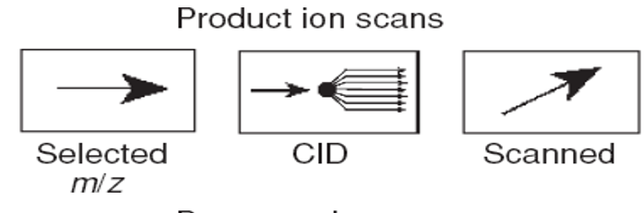
The most common scanning mode is the product ion scan (1). It is based on selecting an ion (parent ion) with a chosen m/z ratio in the first analyzer (Q1). This ion collides inside the central quadrupole (q), which serves as a collision cell and undergoes fragmentation. The reaction products (fragment ions or daughter ions) are analyzed by the second analyzer (Q2). During the process, the second analyzer (Q2) focuses on fragment ions generated during collisions.
It is important to note that those fragments belong to the selected parent ion and serves as a specific “fingerprint” of a given molecule, thus allowing its identification.

Slide 43
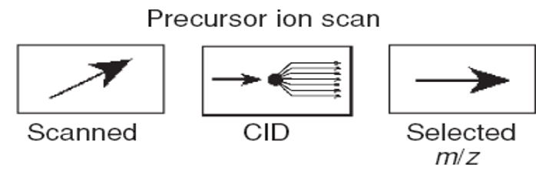
During precursor ion scan (2), the second analyzer (Q2) focuses on a particular product ion of interest AFTER collision, while the first mass analyzer (Q1) scans the m/z ratios. This mode is used to reveal all parent ions (i.e. all molecules in the analyzed mixture) that generate the same daughter ion. This mode can be used for screening for all compounds having similar chemical structure.

Slide 44
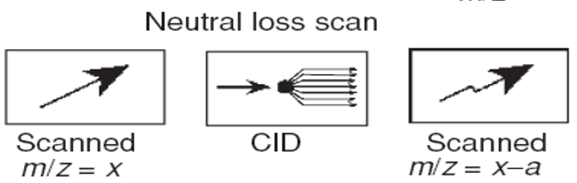
In the neutral loss scan (3), both first (Q1) and second mass analyzers (Q2) operate with a constant mass offset. When precursor ion is transmitted through the first mass analyzer, this ion is recorded by Q2 if it yields a product corresponding to the loss of a specific fragment (specific group) from the precursor ion, e.g. water molecule, phosphate, carbon dioxide, etc., after leaving collision cell (q). This loss provides identification of molecules having specific structural features.

Slide 45
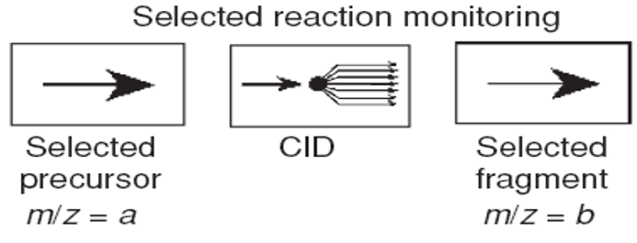
In the SRM (SRM scan mode), the first (Q1) and second mass analyzers (Q2) are both focused on the selected ions with preset m/z, and the instrument is tuned to transmit only the ions derived from fragmentation. It is important to note that fragmentation pathway is much more indicative than the parent m/z value to identify a specific molecule; therefore, SRM mode is more selective than SIM mode used in single quadrupoles. The higher sensitivity obtained by using this method compared with SIM is due to the improved signal‐to‐noise ratio, which is characteristic for fragment mass spectra, and the high duty cycle due to the detection of only one specific ion. In the case that m/z values for multiple ions are preset to monitor multiple reactions, the term “multiple reaction monitoring (MRM)” is used. An additional asset of using SRM is significantly lower occupancy of the hard disk space for data acquisition. This mode is also used to increase sensitivity of the analysis for low‐abundant species.

Slide 46
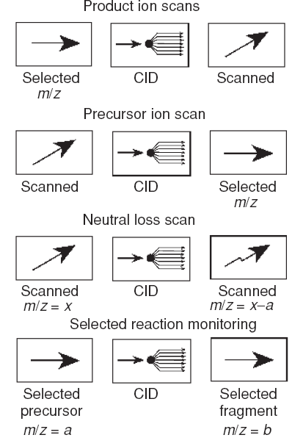
Main processes in tandem mass spectrometry (MS/MS). CID stands for collision-induced dissociation, as occurs when an inert gas is present in the collision cell.
Product ion scan (daughter scan)
Precursor ion scan (parent scan) consists of choosing a product ion (or daughter ion)
Neutral loss scan consists of selecting a neutral fragment and detecting all the fragmentations leading to the loss of that neutral.
Selected reaction monitoring (SRM) consists of selecting a fragmentation reaction.

Slide 47
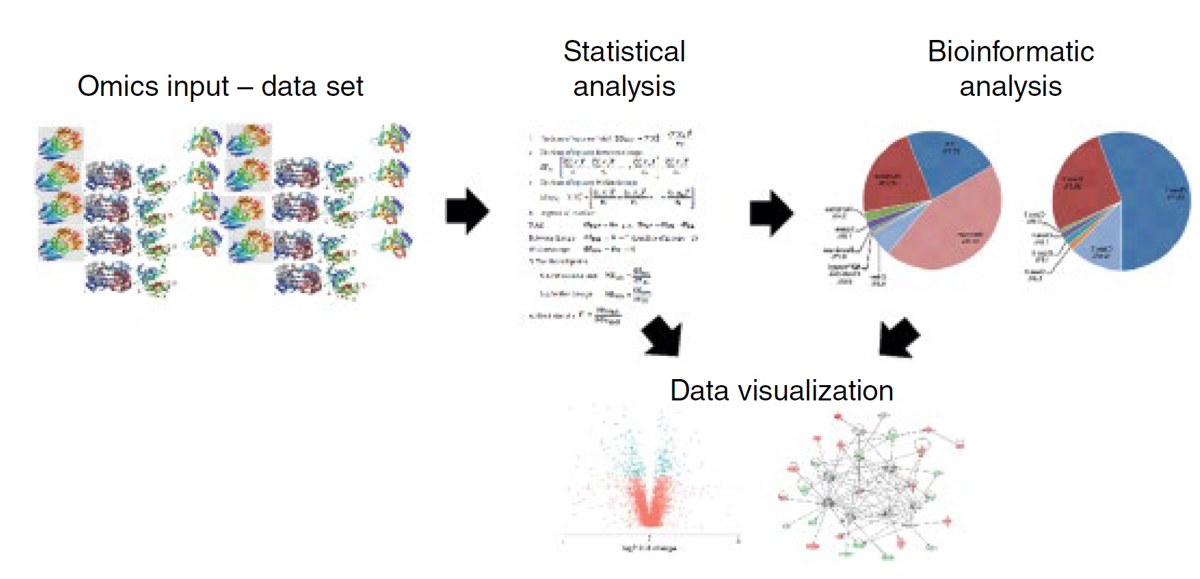
Marek Smoluch, Giuseppe Grasso, Piotr Suder, and Jerzy Silberring, Mass Spectrometry An Applied Approach, Wiley 2019.

Slide 48
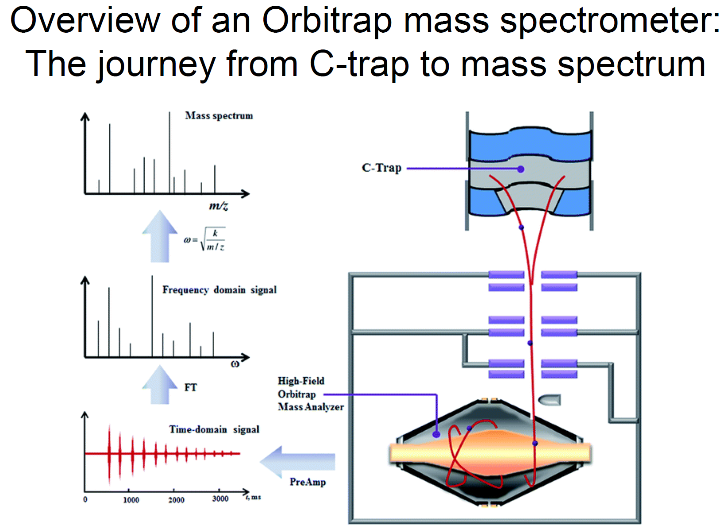

Slide 49
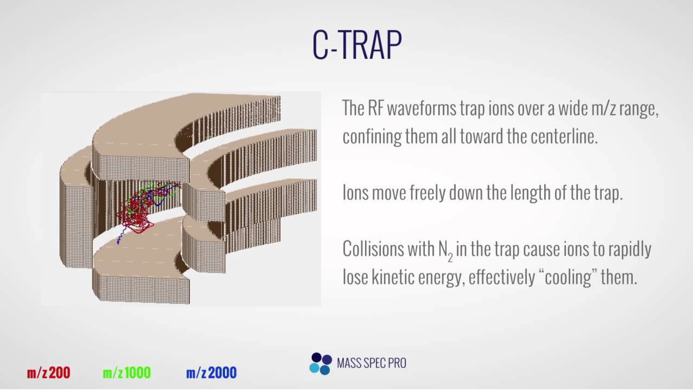

Slide 50
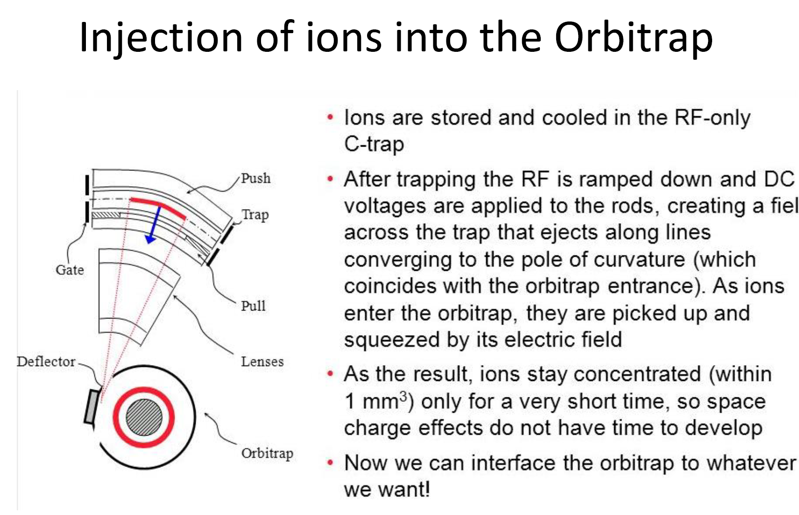

Slide 51
Schematic overview of different mass spectrometer designs used for contemporary proteomics research. Colored squares specify where the three most important experimental steps are executed: precursor isolation (blue), fragmentation (red ), and detection (yellow).
Gillet · Leitner · Aebersold, Annu. Rev. Anal. Chem. 2016. 9:449–72.

Slide 52
DIA methods combine certain aspects of both DDA and SRM methods. As with the targeted acquisition mode, the instrument performs continuous time-resolved acquisition of MS/MS signals for each precursor mass region (Figure 3c).
In contrast to DDA and SRM methods, however, the aim of the DIA mode is to exhaustively acquire MS/MS spectra for any possible precursor mass, regardless of the actual detection (DDA) or the presumed presence (SRM) of peptides/ precursors.
Gillet · Leitner · Aebersold, Annu. Rev. Anal. Chem. 2016. 9:449–72.

Slide 53
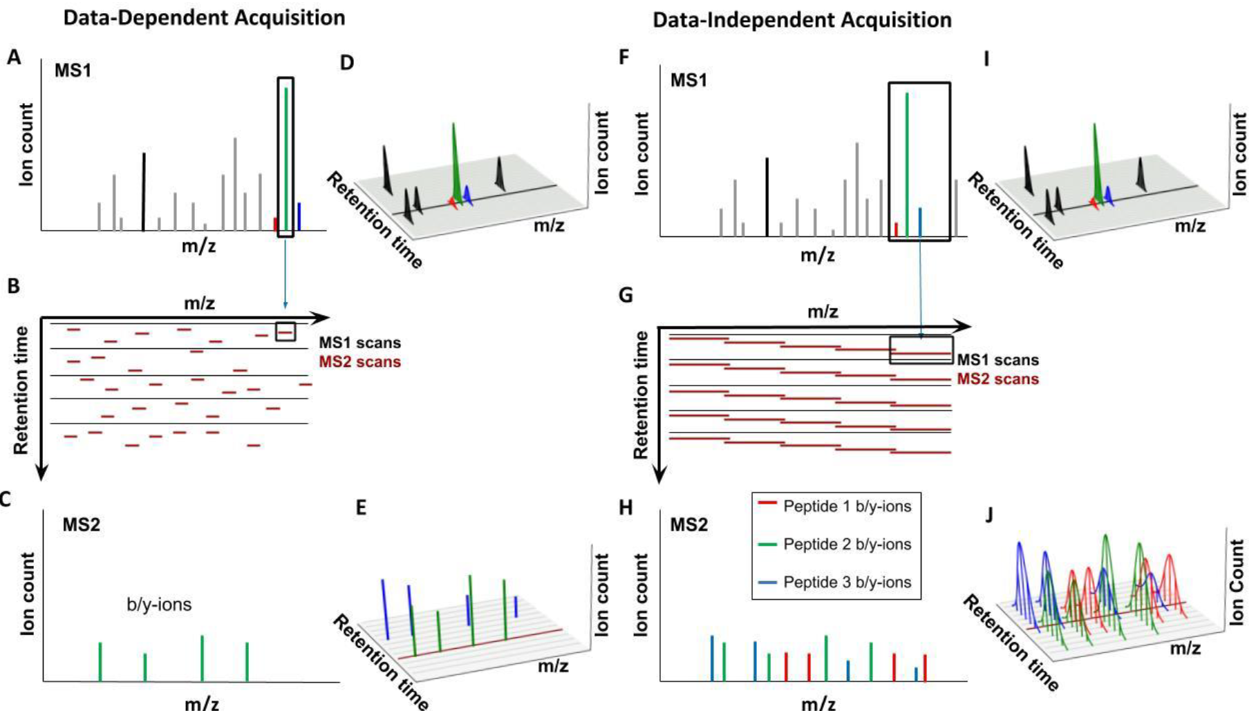
Nishant Pappireddi, Lance Martin, and Martin Wühr, ChemBioChem, 10.1002/cbic.201800650

Slide 54
Quantitative MS

Slide 55
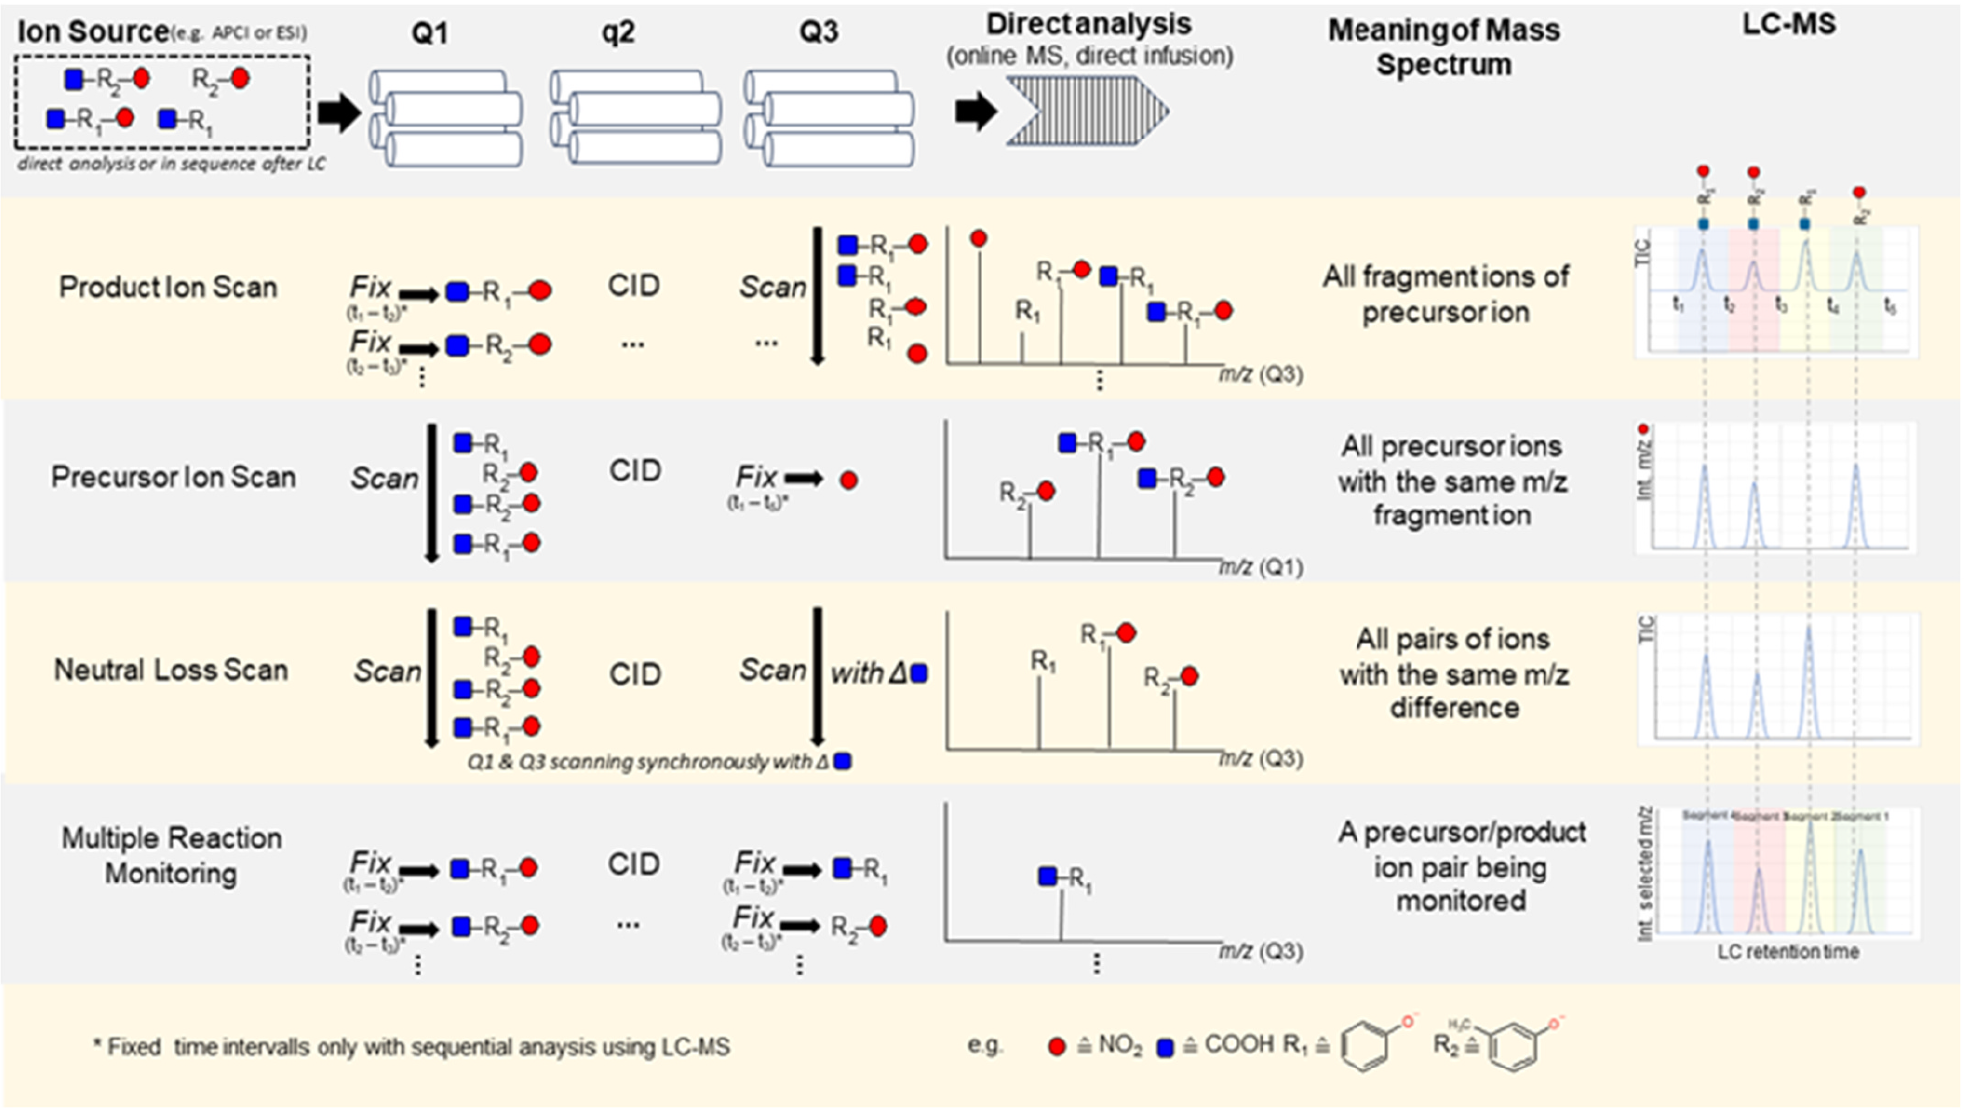
Tandem mass spectrometry scan modes. (1) Product ion scan: selection of precursor ion with Q1 and scanning with Q3. (2) Precursor ion scan: scan all precursor ions in Q1 that produce a specific fragment ion that is selected in Q3. (3) Neutral loss scan: scanning all ions with a constant mass difference in Q1 and Q3 simultaneously. (4): Multiple reaction monitoring: selection of precursor ion in Q1 and monitoring one or more selected fragment ions in Q3.

Slide 56
Selected Reaction Monitoring (SRM)
3

Slide 57
Multiple Reaction Monitoring (MRM)
5

Slide 58
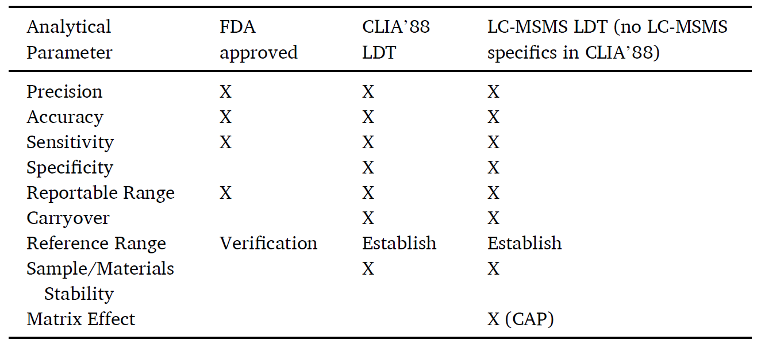
Validation/Verification required by CLIA’88 regulations administered by Centers for Medicare & Medicaid Services (CMS) and CAP to perform laboratory developed test (LDT) versus FDA approved assays.
Judith A. Stone, J. Grace van der Gugten, Journal of Mass Spectrometry and Advances in the Clinical Lab 28 (2023) 82–90.

Slide 59
The primary goal of any clinical laboratory test is to help diagnose and correctly treat patients whose samples are being tested; therefore, accuracy of laboratory tests is critical. Superior accuracy is one reason why LC-MSMS has become a key piece of equipment in the clinical laboratory.
Notoriously, low-level testosterone is inaccurate when measured by immunoassay (IA) [18], but excellent accuracy is achieved when measuring by LC-MSMS [19]. Aldosterone, when measured by IA in patients with chronic kidney disease, is overestimated by as much as two-fold, a phenomenon not seen when measured by LC-MSMS [20].
Thyroglobulin (Tg), a thyroid cancer biomarker, is incorrectly underestimated by IA when autoantibodies are present. This is a significant problem when monitoring for cancer recurrence, and LC-MSMS Tg assays can overcome this problem [21].
Clinical LC-MSMS methods have elucidated problems with IA that have caused misleading results interpretation [22] and have led to assay improvements by the manufacturer [23].

Slide 60
Manufacturers of LC-MSMS platforms do not typically supply FDA-approved tests; they may provide information and materials such as LC and tandem mass spectrometry (MSMS) parameter starting points, reagents, calibrators, and QC materials, but these are limited to a small test menu.
Furthermore, manufacturers often do not have access to native matrix clinical patient samples, and vendor methods are typically developed using a simplified matrix that does not contain endogenous interferences seen in genuine patient samples.
Judith A. Stone, J. Grace van der Gugten, Journal of Mass Spectrometry and Advances in the Clinical Lab 28 (2023) 82–90.

Slide 61
Assay development should include thorough investigation of matrix effects. Matrix effects testing is required for QntLCMS-LDT by some agencies with CMS deemed accreditation status (CAP) but not by CLIA’88. A known risk in QntLCMS-LDT methods is sample specific inaccuracy beyond acceptable limits due to matrix effect. Due to the nature of ionization in the MSMS source, sample matrix can suppress or enhance analyte ionization. Although it is not possible to reduce matrix effects entirely, they should be sufficiently understood and mitigated to the extent that is feasible. Ideally, matrix effects should be minimized and standardized between patient specimens. Typically, this is achieved by sample preparation which varies in its ability to remove sample matrix, and by the addition of stable isotope-labeled internal standards (SIL). Appropriate use of SIL usually, but not always, compensates for variable ionization due to matrix effect. Thorough assessment of matrix effects should be performed during method development so that mitigation measures (i.e., changes to sample preparation procedures, SIL) can be made prior to embarking on method validation.
Two types of matrix effect experiments are described in guidance documents: quantitative, involving spike-and-recovery type experiments, and qualitative post-column T-infusion experiments. Post-column infusion is less effort than the quantitative matrix effect experiment, but it is not required by CLIA’88 or CAP regulations. It is a valuable tool during method development for comparing sample preparation techniques and LC gradients to reduce ion suppression risk. The qualitative matrix effect experiment should be thought of as a method development tool (visualizing ion suppression) rather than a method validation experiment with pass/fail criteria. Deriving acceptance criteria for qualitative data (the timeframe of matrix effect) is more difficult than for quantitative data (how much matrix effect).

Slide 62
Quantitative Methods for Proteomic

Slide 63
Classical 2-DE based proteomics
2DE-based, quantitative proteomics dates back to the invention of 2DE in 1975 by O’Farrel and Klose, when two orthogonal physicochemical properties of the proteins to be analyzed (pI and M_{r}) were utilized to resolve thousands of protein species on a 2D gel, combining IEF in the first and SDS PAGE in the second dimension.
The classical proteomic quantification methods are:
Dyes,
Fluorophores,
or Radioactivity.
Proteomics 2014, 14, 547–565

Slide 64
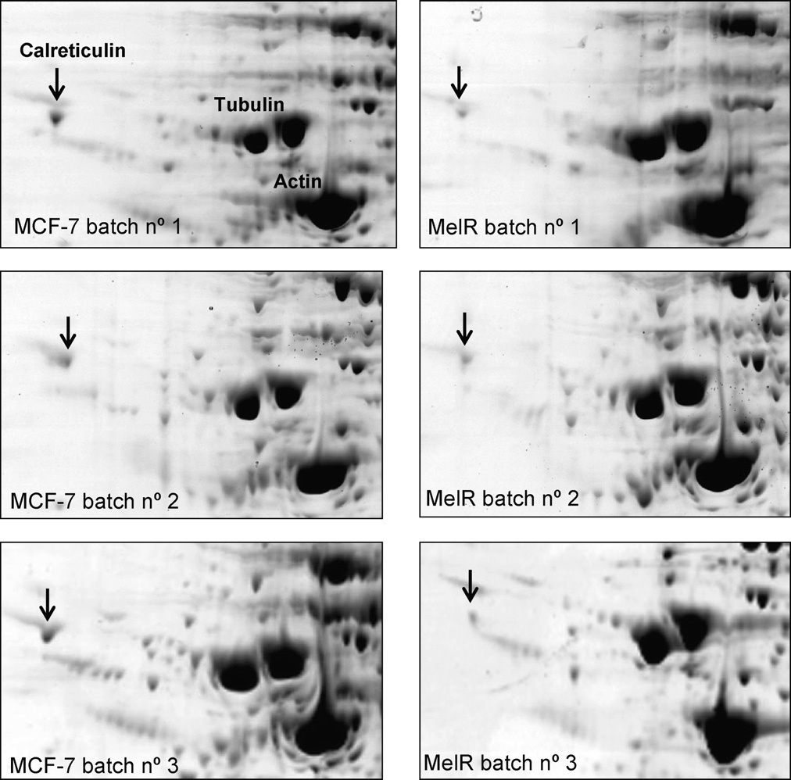
Quantification of cytosolic proteins recovered from human breast cancer MCF-7 cells susceptible and resistant to the anticancer alkylating agent, melphalan, after treatment by Ag.
C. Fenselau / J. Chromatogr. B 855 (2007) 14–20

Slide 65
Drawbacks of MS Quantitative
The efficiency of the ionization process can differ by orders of magnitude for different peptides.
Additionally, the efficiency of protein conversion into analyzable peptides can also vary drastically due to different digestion efficiencies and/or peptide solubility. Therefore, the number of ions inside the MS is not a direct readout of how many proteins were originally in the sample.
Because of this problem, MS is an inherently non-quantitative method and significant additional efforts are required to obtain quantitative information.
Nishant Pappireddi, Lance Martin, and Martin Wühr, ChemBioChem, 10.1002/cbic.201800650

Slide 66
Absolute and Relative Quantification in Proteomics Experiments
For the relative quantification of proteins between two or more samples, their peptides must first be relatively quantified from each sample it is possible to compare peaks of the same peptide, with the same ionization efficiency, in different samples, which is what relative quantification is based on.
Absolute quantify relative to an added spiked-in standard, with known absolute concentration. Due to the high costs of such standards, these experiments are typically limited to studies of a smaller subset of the proteome. While not directly correlated, the total ion-signal of a protein seems to be related to its in vivo abundance via a power law. Using an internal standard, the absolute protein abundance for all proteins detected in a sample can therefore be inferred, but this comes with a wide median ~2-fold error.

Slide 67
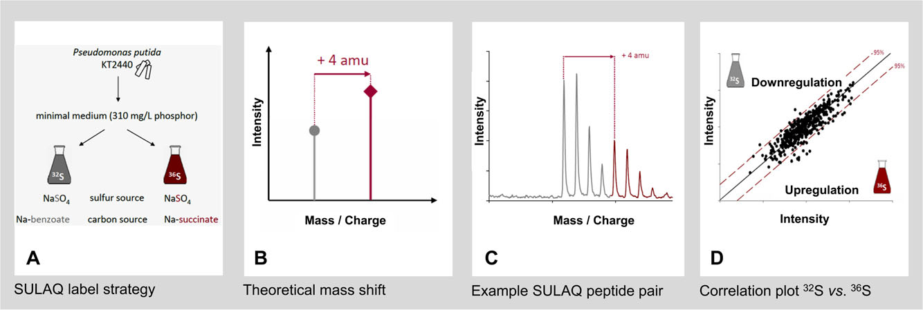
Stable isotope probing (SIP)
Proteomics 2014, 14, 547–565

Slide 68
SILAC
(Stable Isotope Labeling by/with Amino acids in Cell culture)
SILAC was introduced in 2002 with an immediate success in quantitative proteomics for eukaryotic cell lines. Analogous to its predecessor, SIL, SILAC is based on metabolic incorporation of heavy labeled amino acids during cell growth into all proteins expressed in the living cell.
For relative quantification studies, protein extracts of light (unlabeled) and heavy labeled samples are mixed and can consequently be distinguished on the molecular level by their difference in mass. Most advantageous for shotgun proteomics is the use of heavy isotopomers of arginine and lysine to ensure that all peptides resulting from proteolytic cleavage by trypsin or LysC contain at least one heavy labeled amino acid.
Proteomics 2014, 14, 547–565

Slide 69
Despite all the advantages that have led to the success of SILAC, the technique has inherent drawbacks that
The already mentioned auxotrophy for SILAC amino acids, an interconversion of amino acids (arginine to proline) has been observed, which requires countermeasures.
In addition, using stable isotope labeled amino acids is quite expensive due to the high purity needed (usually >98%) and the relatively high concentrations needed to supplement the media.

Slide 70
Relative quantitation : stable isotope labelling is very fashionable!
Sample A : light isotope Sample B : heavy isotope
mix, digest
Quantitate and identify ( MS)
Δm = 9 Da
Peptide from sample B
Peptide from sample A

Slide 71
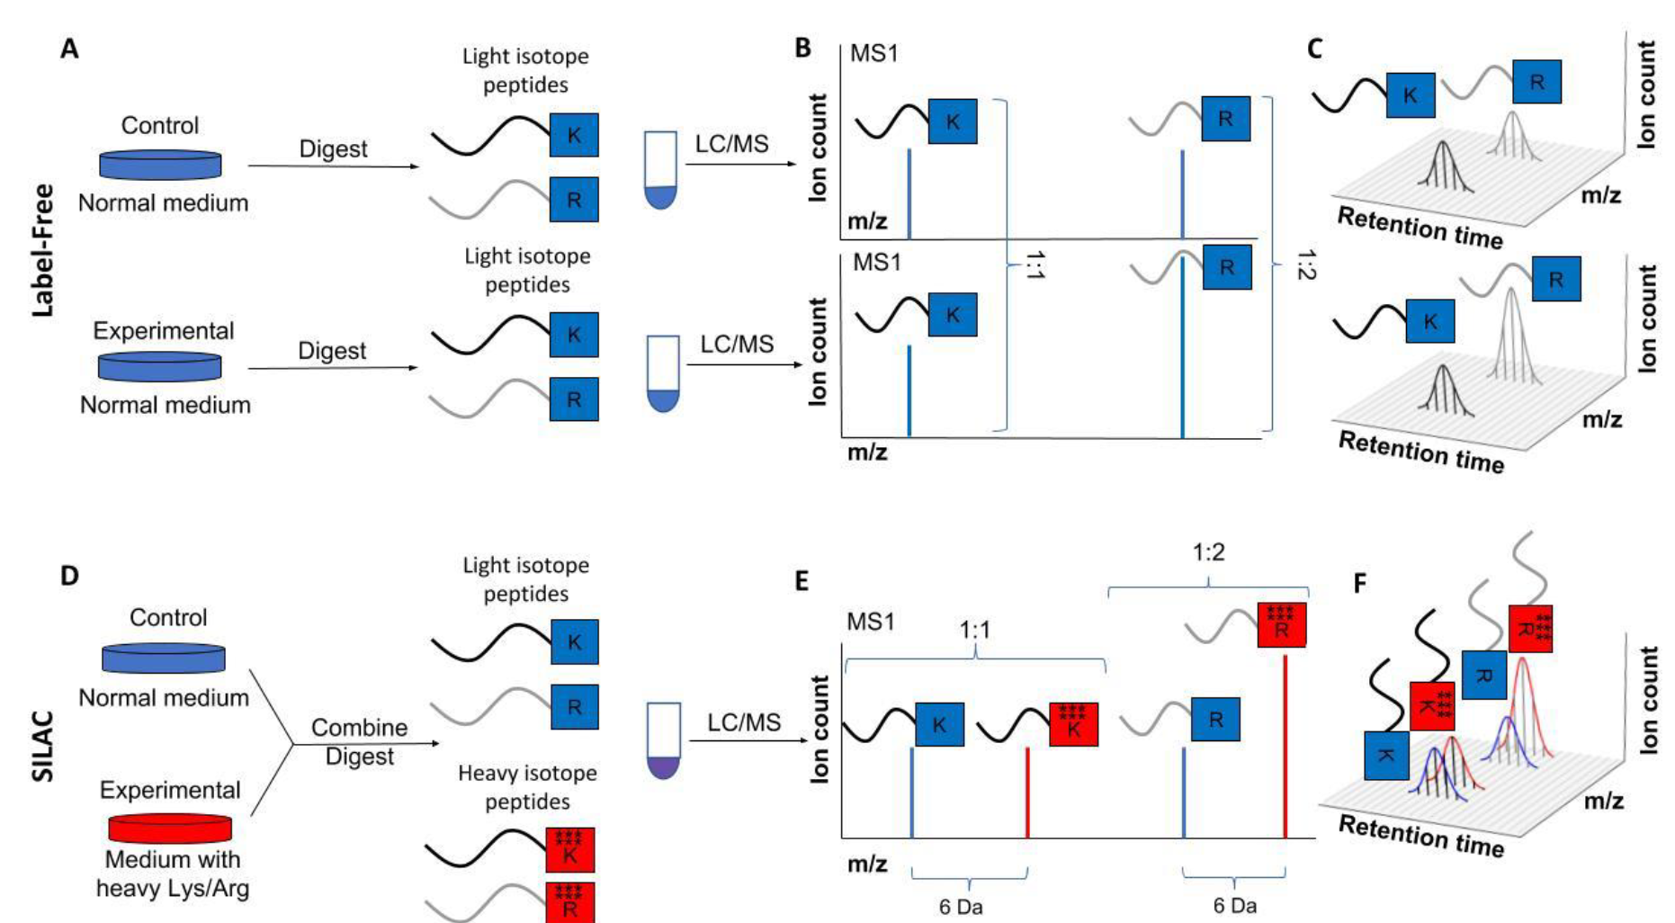
Outline of label-free and SILAC quantification.
Nishant Pappireddi, Lance Martin, and Martin Wühr, ChemBioChem, 10.1002/cbic.201800650

Slide 72
¹⁵N labeling
¹⁵N labeling is the second labeling approach that relies on metabolic incorporation of heavy stable isotopes into proteins during cell growth. In contrast with SILAC, ¹⁵N labeling exchanges all biologically available nitrogen in the growth media for heavy ¹⁵N nitrogen. As a result, no auxotrophies are needed in the organisms under investigation. In the simplest case, this can be an ammonium salt, while for other bacterial systems growth in complex, completely ¹⁵N labeled media is required.
Unlike with SILAC, the mass differences between the heavy and light peptides compared in quantitative studies are not fixed. This makes pair matching of the two isotopologues more difficult in ¹⁵N labeling as compared with SILAC, which can be a drawback in data analysis. However, an advantage of ¹⁵N labeling over SILAC is the robustness with respect to an incomplete labeling that allows successful relative quantitative studies anyway.

Slide 73
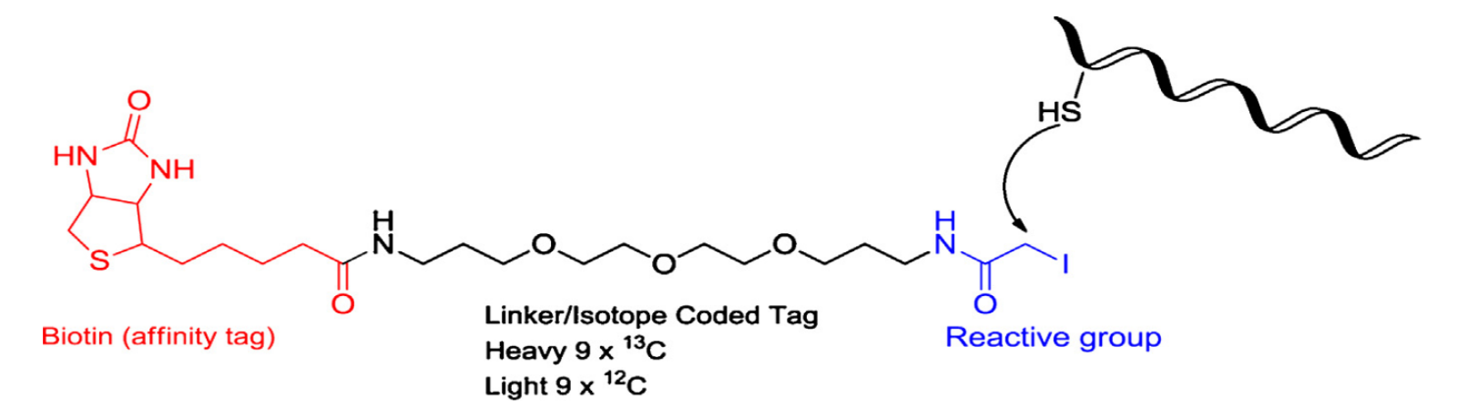
ICATs (Isotope-coded affinity tag reagents)
ICATs, introduced by Gygi and co-workers in 1999.
ICATs are biotinylated iodoacetamide derivatives (or acrylamide derivatives) that react with the sulphhydryl groups of denatured peptides cysteine side chains (as this group of reagents can only be applied to proteins with a cysteine moiety).
If you can see this tag (by MS, MS/MS or others), you can find quantity of attached proteins. Different isotopes of tag causes to have different tags for different cysteine free protein for quantitative analysis in mixture.
O. Chahrour et al. / J. Pharm. Biomed. Anal. 113 (2015) 2–20.

Slide 74
The intermediate bridge of these reagents, contains the isotopic carbon or hydrogen atoms used for differential labelling, connecting iodoacetamide to a biotin group for affinity capture of the derivatised peptides onto a streptavidin based column.
The biotin–streptavidin affinity capture allows cysteine-containing peptides to be isolated from the complex sample mixture,

Slide 75
The ICATs, both the heavy and the light version, consist of three functional parts:
a protein-reactive group,
an isotope-coded linker, and
the affinity tag.
Designed as nonisobaric in the first generation, the heavy version was characterized by an additional mass of 8 amu due to the exchange with deuterium of eight protons from the isotope coded linker. For relative quantitation, the cysteine residue labeled protein samples are mixed, proteolytically digested, and the tagged peptides are affinity purified prior to LC-MS measurement by incubation with avidin/streptavidin. Post measurement, the mass difference introduced into every cysteine is used for relative quantification on the MS1 level (by the selective labeling using ICAT of thiol groups according to their redox state in different proteomes, gel-free proteomic methods).
Proteomics 2014, 14, 547–565

Slide 76
Isotope Coded Affinity Tag (ICAT) reagents
State 1
Transition states
State 2
[protein₁]
[protein₂]
.
.
[protein_{n}]
[protein₁]
[protein₂]
.
.
[protein_{n}]
O
N
N
O
X
X
X
O
X
O
I
S
N
X
O
O
X
N
d0- or d8-ICAT
X
X
Biotin tag
Linker (heavy or light)
Thiol
reactive
(X= H or D)

Slide 77
New Methods : ICAT:quantitation and identification
Cell State 1
Cell State 2
Modify with
(H8)-ICAT
Modify with
(d8)-ICAT
H
H
H
H
D
D
D
O
I
D
O
I
Biotin
N
H
Biotin
N
H
H
Combine samples
H
H
H
D
D
D
D
HS-
-SH
Digest Trypsin
Purify Cys-containing
peptides on avidin column
Identify proteins by MS/MS
A1
B2
aa4
aa2
aa1
Intensity
B1
A3
aa3
A2
Intensity
m/z
Quantitate protein levels
by H8 / D8 peak heigth ratios
m/z

Slide 78
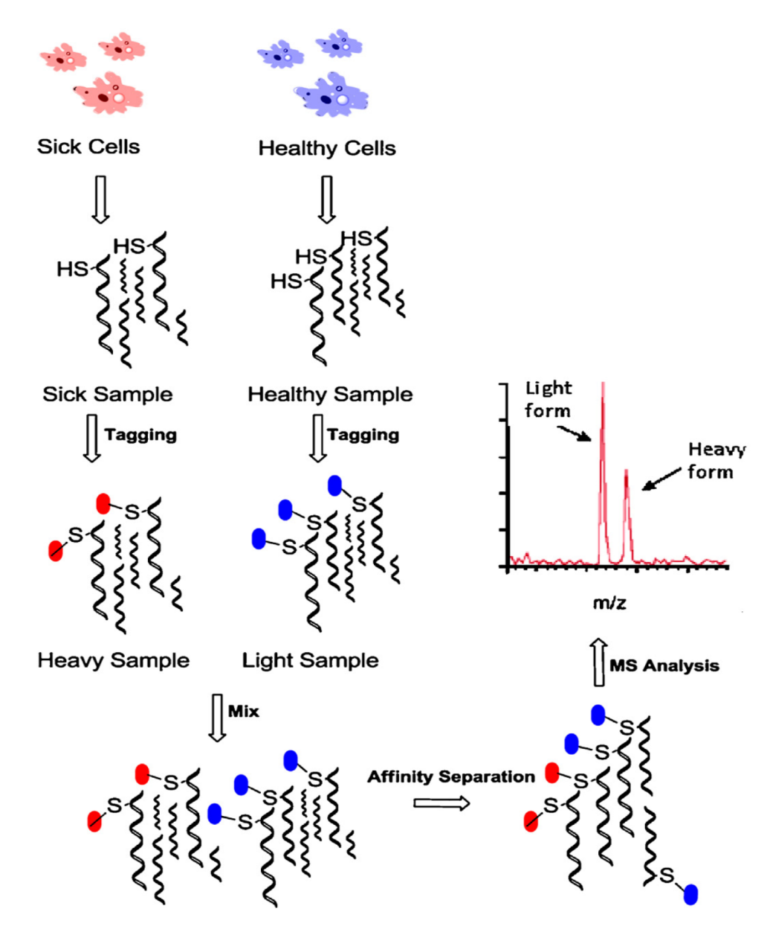
For one shot mass spectrometry analysis, the linker bridge is available in two forms, one normal/light version and one heavy form, in which hydrogen or carbon atoms are replaced by deuterium/¹³C.
Two samples derived from two different cell states (sick cell vs healthy cell) are treated with the light (healthy) or heavy (sick) ICAT tags.
Also, these two forms (light and heavy) can cause to have two difference hydrolyzed peptides forms for quantitative analysis.

Slide 79
Peptides labelled using deuterated ICAT reagents are however liable to chromatographic peak separation resulting in an inconsistent ratio across the peak. Zhang and co-workers revealed that the substitution of ¹H for ²D changes the retention time of the labelled species in liquid chromatographic separation RP-HPLC. They demonstrated that even a baseline separation of the light and heavy labelled counterparts can be obtained. This problem has been overcome by using ¹³C labelling of the heavy version ICAT reagent.
Another issue is that the presence of the biotin group mass in the spectrum may interfere with database search, and its hydrophobicity causes peptides to elute in a relatively narrow retention time window.
A cleavable cICAT reagent has therefore been introduced, wherein, the biotin can be removed by acid treatment before mass spectrometry analysis.

Slide 80
Drawbacks:
The major disadvantage of ICAT reagents is that, some proteins do not have a cysteine residue and therefore are excluded from this type of analysis.
Another more practical drawback of this method is that the release of the biotinylated peptides from the streptavidin column is not quantitative for low abundance peptides.
O. Chahrour et al. / J. Pharm. Biomed. Anal. 113 (2015) 2–20.

Slide 81
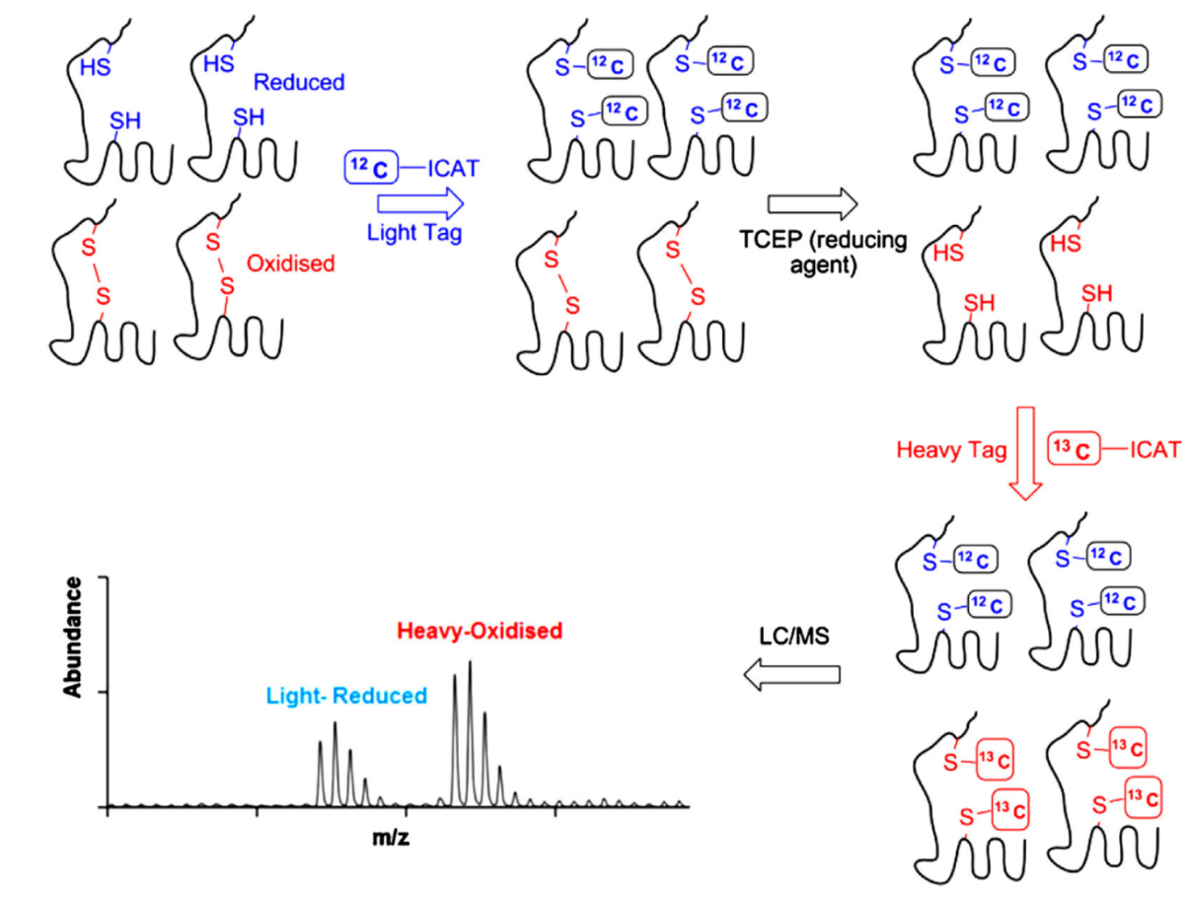
For finding ratio between oxidase to reduced protein forms, in the first step of OxICAT work-flow, the protein is denatured to gain access to all reduced cysteines and label them irreversibly with light ICAT. Next, all reversibly oxidised thiol are reduced using the strong thiol reductant Tris(2-carboxyethyl)phosphine (TCEP) and then are tagged with heavy ICAT. This procedure generates two forms of chemically identical proteins, that only differ in the mass of their ICAT-labels (9 Da more for each heavy ICAT label) depending on their initial redox state.

Slide 82
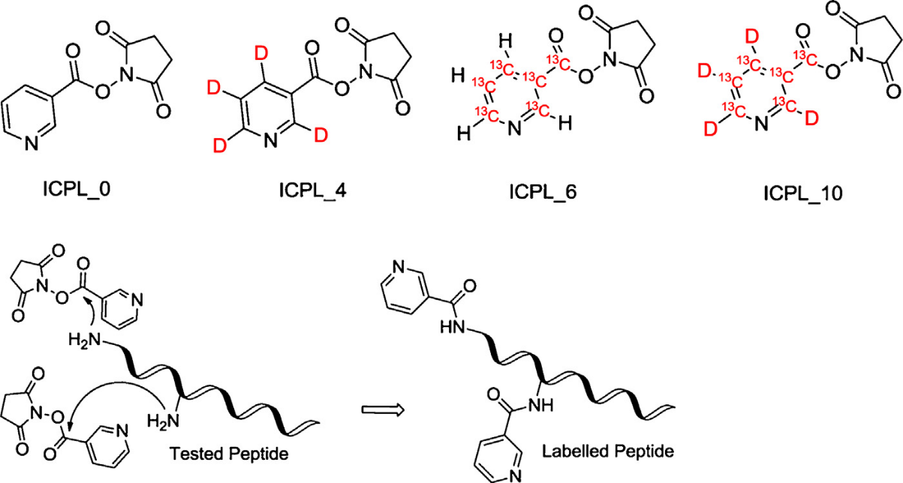
Non selective isotope-coded protein labelling (ICPL)
ICPL reagents label lysine side chains and N-termini based on the unique ability of N-hydroxysuccinimide(NHS)-nicotinic acid ester derivatives to fully derivatise primary amino groups. Similar in principle to ICAT labelling, ICPL reagents also have variants with different numbers of deuterium atoms to allow multiplex quantitative analysis. For example, the ICPL Quadruplex method used ICPL 0, ICPL 4 (4 Deuteriums), ICPL 6(6¹³C) and ICPL 10 (4 Deuteriums + 6¹³C) reagents allowing the simultaneous quantitation of four independent samples. Similar strategies to ICAT include the specific labelling of the exposed N-termini of peptides with alternative light and heavy forms of chemicals similar to N-acetoxysuccinimide and 1-nicotinoyloxysuccinimide.

Slide 83
Drawbacks:
Nevertheless, the main drawback lies within the fact that only 60–70% of identified proteins can subsequently be quantified. This is partially due to the fact that not all lysine containing peptides of a particular protein are typically sighted in a typical LC–MS run.
A further difficulty is associated with protease digestion of the labelled proteins. The labelling of lysine residues prevents the digestion by trypsin which will only be effective at the arginine residues.

Slide 84
Isobaric mass tags (iTRAQ and TMT)
Today, the most successful chemical tags (no isotopic tag) are the commercially available isobaric mass tags called TMTs and iTRAQ that isobaric ion is an ion with an identical mass to others, but with different atomic compositions. A common example is a positive ion at m/z 28, which can have empirical formulas of CO, N2 or C2H4. The non-isobaric tagging (two forms appear as two peaks with a certain mass difference in the mass spectrum) .
Compared to metabolic labeling, chemical labeling lags behind in broad application in microbial proteomics.

Slide 85
The relative abundances of the isobarically tagged peptides are revealed when the moieties fragment during MS/MS experiments to release reporter ions with different masses (different peptides with same mass, appear distinguish masses after attach to isobaric tagged in MS/MS condition.
The amine-reactive group of the tag (N-hydroxysuccinimideester-activated compounds) covalently binds to the peptide amino terminus and free amino termini of lysine residues of peptides and proteins with high efficiency. In addition to the reactive group, the isobaric mass tags are designed to include two parts: a reporter or signature region and a mass normalising region called the balancer. The total mass of the reporter region and the balancer is the same in all versions of the isobaric reagent, but the individual weights change. Consequently, when the reporter ion is released in MS/MS spectrum it can be correlated to a particular sample source. Two types are: TMT and iTRAQ.

Slide 86
Tandem Mass Tags (TMT)
Quantitation of TMT labelled peptides requires MS/MS fragmentation using instruments such as QTOF, IT, TOF/TOF or QQQ. Many publications have followed manufacturer recommendations to use higher energy collision dissociation (HCD) for TMT reporter ion fragmentation. The least expensive kit (Thermo co.), TMT zero Reagents, can be used to find the instrument-dependent optimal HCD fragmentation energy for the experiment. Electron transfer dissociation (ETD) may also be an alternative fragmentation method for the analysis using this family of reagents. Alternately, CID MS/MS fragmentation with TMT reagents have been successfully implemented and reported in literature with QTOF instrument and with TOF–TOF spectrometers. TMT reagent reporter ions are however not visible in ion traps following traditional CID fragmentation.
Notes:
اساس این تکنیک بر این مبنا است که ما یک قسمت خبر ده در داخل یک مجموعه که دارای سه بخش است داریم این مجموعه سه بخشی علاوه بر بخش خبرده یک قسمت متعادل کننده و یک قسمت فعال واکنش دهنده نیز دارد.
زمانیکه این مجموعه در کنار هم در کنار ماده ایکه می خواهیم آنالیز کنیم قرار دهیم کل این مجموعه به این ماده مورد نظر متصل می شود. MS/MS کمک می کند که قسمت خبر کننده بتواند از کل این مجموعه به هم چسبیده شده جدا شود و به تنهایی یک پیک با جرم مشخص دهد که این نشان دهنده مقدار واکنش است که حالا این جرم حاصل واکنش، در MS/MS می شکند. هر مقدار مقدارخبردهنده بیشتر باشد یعنی واکنش بیشتر بوده و ماده ما بیشتر تشکیل شده است که می تواند اینجا بشکند و خبردهنده را بدهد. بنابراین یک شاخص خوب کار کمی خواهد بود.
این تکنیک زمانی ارزش بیشتر پیدا می کند که چند بیمار از انواع مختلف به همراه نمونه سالم شان باشند که بتوانند با گروه فعال این ماده سه جزئی واکنش داده که در اینصورت هر یک، یک خبردهنده مشخص خود را داشته و در MS/MS آن را نشان می دهد که نشان دهنده فعالیت فرضا فلان پروتئین دراین حالت های مختلف بیماری نسبت به حالت انسانی است.

Slide 87
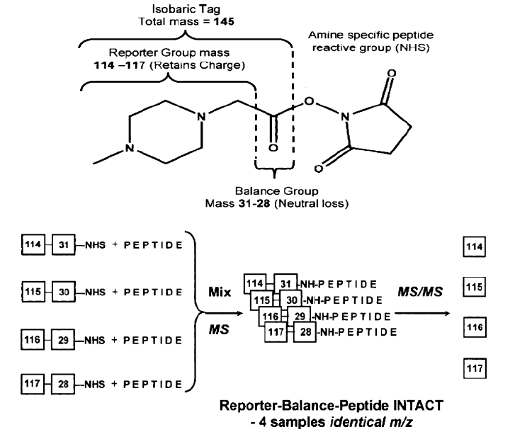

Slide 88
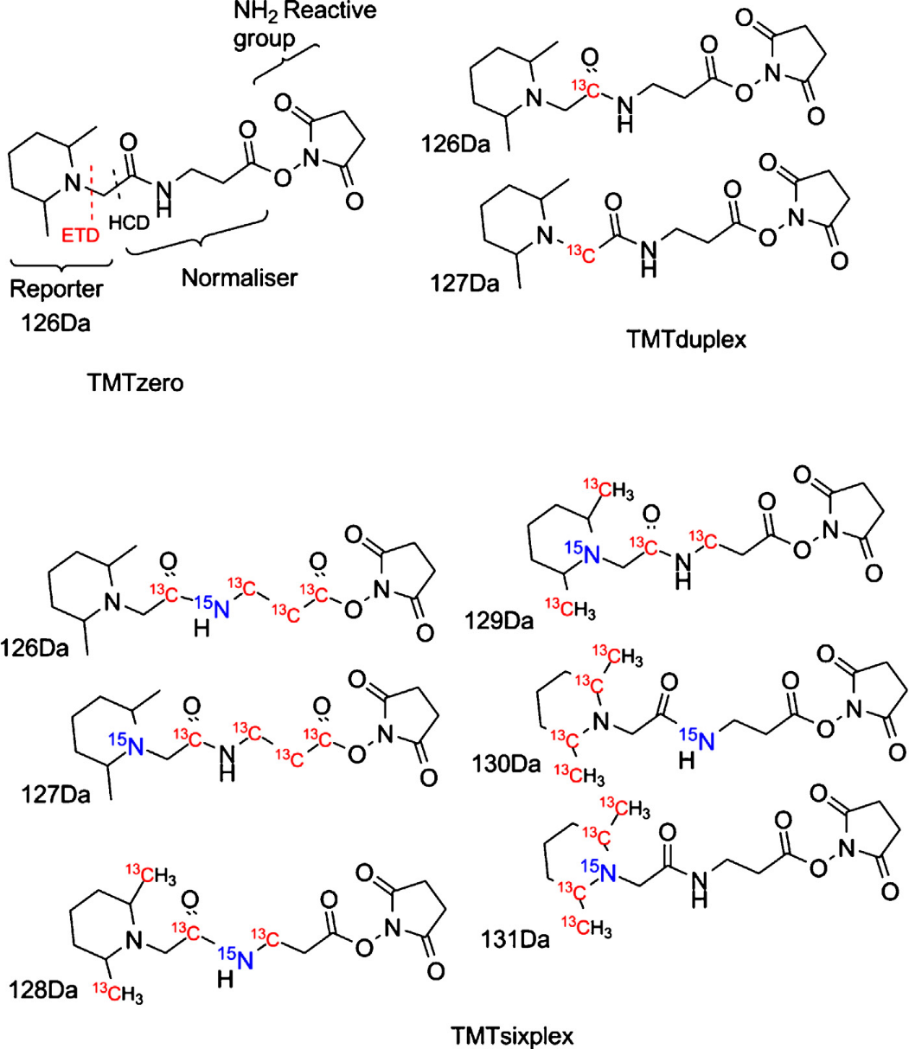
TMT reagents structure up to sixplex

Slide 89
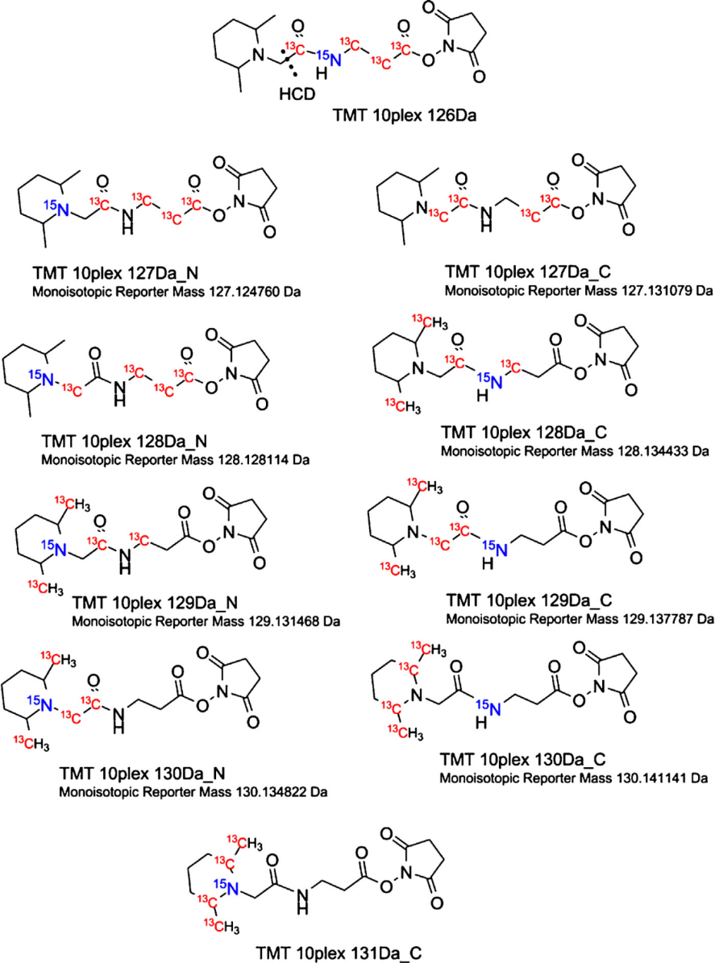
TMT10plex structure and isotopic masses of reporter ions for the C and N versions.

Slide 90
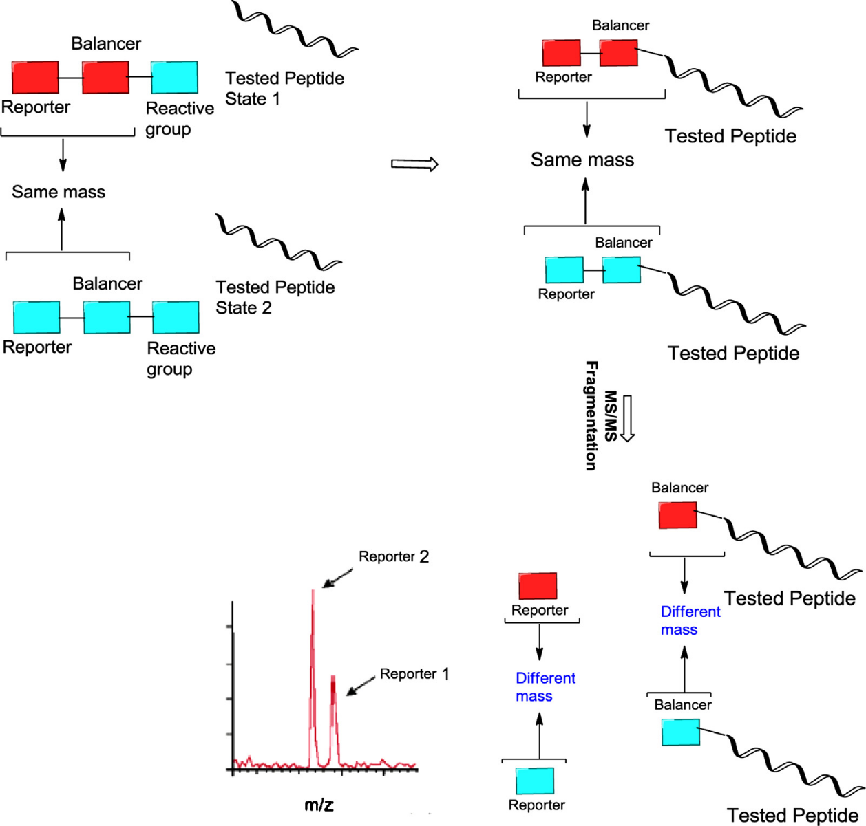

Slide 91
Unlike ICAT, TMTs rely on protein chemistry targeting primary amines of proteins or peptides by N-hydroxysuccinimide esters. This robust chemistry links the Tag with its three functional subunits to the analyte:
the amine reactive group already mentioned,
the reporter group,
and the balancer group.
Although TMT and iTRAQ are different in chemical structure, both provide multiplexing up to 8-plex by variation of the masses encoded in the reporter group visible in fragment ion spectra and its engineered counterpart for providing isobaricity. Once the isobaric tags have reacted with the proteolytic peptides, the mass tags lead to increased masses of all N-termini and ԑ-amino groups.
Further, the isobaric mass tags add up together to the signal intensity of the respective peptide on the MS1 level, for up to eight isobaric tags. Upon fragmentation of the chemically identical peptide masses bearing the isobaric TMTs, the chargeless balancer group becomes invisible for mass spectrometric analysis and the reporter ions reflecting the relative abundance of peptide species of the proteome samples compared appear in the lower region of the fragment scan.

Slide 92
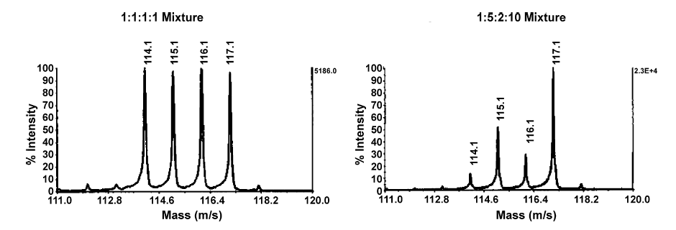
Partial MS/MS spectra of peptides from (left) an equimolar mixture of four protein samples, and (right) a 1:5:2:10 mixture of four protein samples, each labeled with a different isotopically enriched derivative of methylpiperazine acetic acid N-hydroxy succinimide ester.

Slide 93
Isobaric tags for absolute and relative quantification (iTRAQ)
This family of reagents was developed by Applied Biosystems (now AB Sciex) and can easily be multiplexed, allowing analysis of up to 8 different samples within the same experiment. The reagents were initially designed for the simultaneous multiplexed analysis of up to 4 samples, but are available as an 8-plex kit since 2007.
The iTRAQ tags react with all primary amines functional groups of peptides including the N-terminus and ԑ-amino group of the lysine side-chain. This means almost all peptides present in the analysed sample are labelled and information about their modifications/quantities can be obtained. The isobaric nature of the reagents means that the same peptide from each of the samples/biological conditions being compared is seen as a single peak in the mass spectrum. This will reduce the density of the data when comparedt o other labelling workflows, where heavy and light editions of each peptide are observed in the mass spectrum. Each label hasa peptide reactive group, a reporter group and a balancer group to maintain a constant mass increase in the tagged peptide of 145 Daand 305 Da for the 4-plex and 8-plex versions respectively.

Slide 94
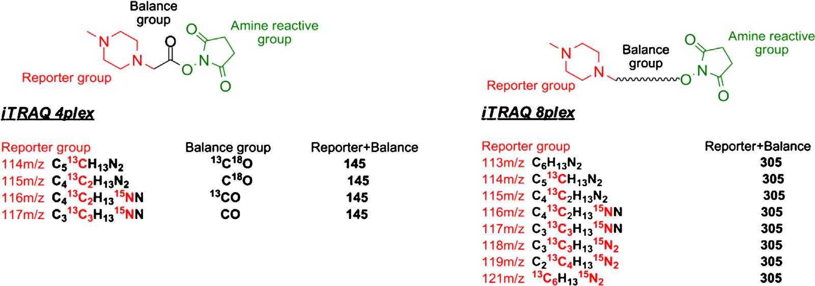

Slide 95
Label free
In label-free quantitation there are two main concepts applied for comparisons: the first is quantitation based on spectral counting; the second is quantitation based on AUC determination on the MS1 level, where the total signal of the monoisotopic peak is counted.
The drawbacks of label free due to the impact of protein length and run-to-run variations in the LC are used for normalizing the spectral counts of each single protein: the summed-up spectral counts of each protein are divided by its length and this value is normalized by the total number of peptide spectrum matches in a sample. Variations of the spectral counting concept are, for example, protein abundance index, exponentially modified protein abundance index (PAI), and absolute protein expression (APEX).

Slide 96
MaxQuant was chosen for evaluation due to its wide acceptance as an academic and free software used mainly for SILAC quantification. Finally, the OpenMS pipeline was selected for evaluation because it shows a high versatility toward new, data-independent acquisition methods in proteomics.
Proteomics 2014, 14, 547–565

Slide 97
Schematic representation of the two different label-free approaches. In the spectral-counting approach (left) peptide and protein abundances can be estimated based on the number of acquired peptide spectrum matches. In the ion-intensity-based approach (right) the changes of peptide abundances are determined by measuring and comparing the chromatographic peak areas of the corresponding peptides. In this example, both results would indicate a higher peptide abundance in State A.

Slide 98
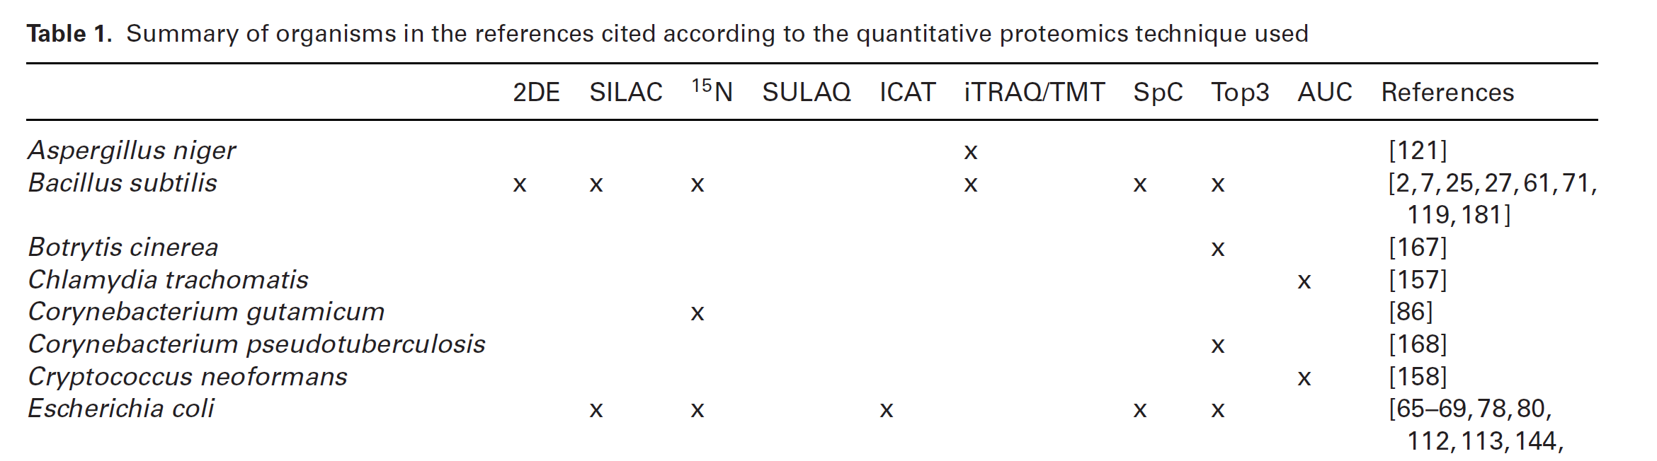

Slide 99
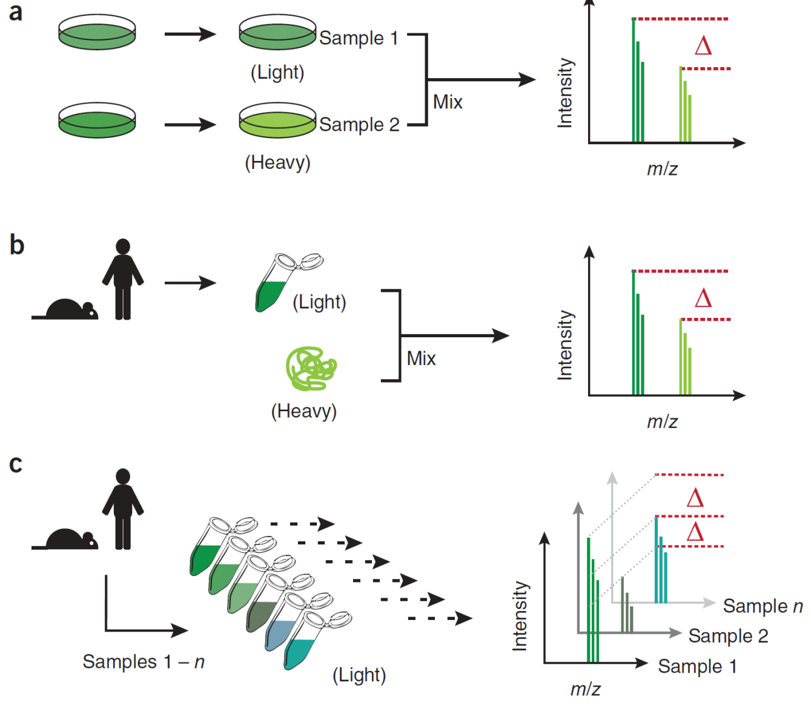
Strategies for quantification of peptides from MS1 spectra.
In a typical SILAC experiment, cells are grown in medium containing amino acids labeled with different isotopes to incorporate the isotopes into cellular proteins. Samples from the conditions to be compared are combined before analysis.
(b) For absolute quantification light isotope–labeled sample, primary tissue is spiked with known amounts of protein with heavy isotope label. For a and b, samples are prepared after mixing the samples or spiking in the standard, respectively, and peptides are analyzed together by LC-MS. SILAC quantification is based on the differential intensities of coeluting peptides with identical amino acid sequence but with distinct isotope labels.
(c) In a label-free approach, peptides derived from any biological sample are prepared separately and analyzed by LC-MS sequentially. Label-free quantification is based on the differential intensities of eluting peptides with identical amino acid sequence and mass between separate LC-MS runs. D indicates quantitative peptide differences.

Slide 100
Absolute quantitation by mass spectrometry (AQUA strategy)
Synthetic internal standards

Slide 101
In the most common application to proteomics, peptides are selected, based on uniqueness, stability, sensitivity to ionization techniques, etc., as surrogate markers for proteins of interest, and internal standards are added to allow these proteotypic peptides to be quantified.
The best internal standards are peptides that have identical sequences as the biomarker peptides, and carry stable isotopic labels. Precise quantification of small organic molecules using stable isotope (²H,¹³C,¹⁵N,¹⁸O) labelled analogues as internal standards has been widely implemented in mass spectrometry.
The AQUA (absolute quantification) workflow was introduced in 2003 and can be described as a modification of isotope dilution mass spectrometry that includes the use of synthetic labelled peptide as internal standards.

Slide 102
Targeted and data independent acquisition
In contrast to immunoaffinity-based workflows typically used in biological and clinical research for protein quantification, selected/multiple reaction monitoring (SRM/MRM) is characterized by high selectivity, large capacity for multiplexing (approx. 200 proteins per analysis) and rapid, cost-effective transition from assay development to deployment.
The targeted MS/MS technique of selected reaction monitoring (SRM, sometimes referred to as multiple reaction monitoring, MRM), was implemented in proteomics to enable reproducible, sensitive and selective protein assays

Slide 103
The label‐free technique presents a completely different principle of operation, while two different approaches to this technique are known. T
he first approach is referred to as spectral counting and involves collecting and comparing the number of MS/MS fragmentation spectra obtained for the peptides of a given protein. Due to the fact that the number of tandem mass spectra of peptides increases with increasing amount of the corresponding protein (more protein – more identified peptides), it is possible to quantitatively determine the proteins between different samples.
However, the use of this type of solution is controversial because the principle is based on quantitative calculation of the collected spectra rather than on the measurement of physical quantities.
Nevertheless, the spectral counting method is widely used and being further developed. An alternative use of the label‐free approach assumes measuring the area under the peaks of precursor peptide ions (Figure 8.11). Depending on the chromatographic method (e.g. reversed‐phase LC), the peptides are separated according to their physical properties, then ionized in the ion source and finally analyzed. The intensity of the monoisotopic peak as a function of the retention time is shown on the extracted ion chromatogram (EIC) so that the area under the peak can be calculated [2, 10].

Slide 104
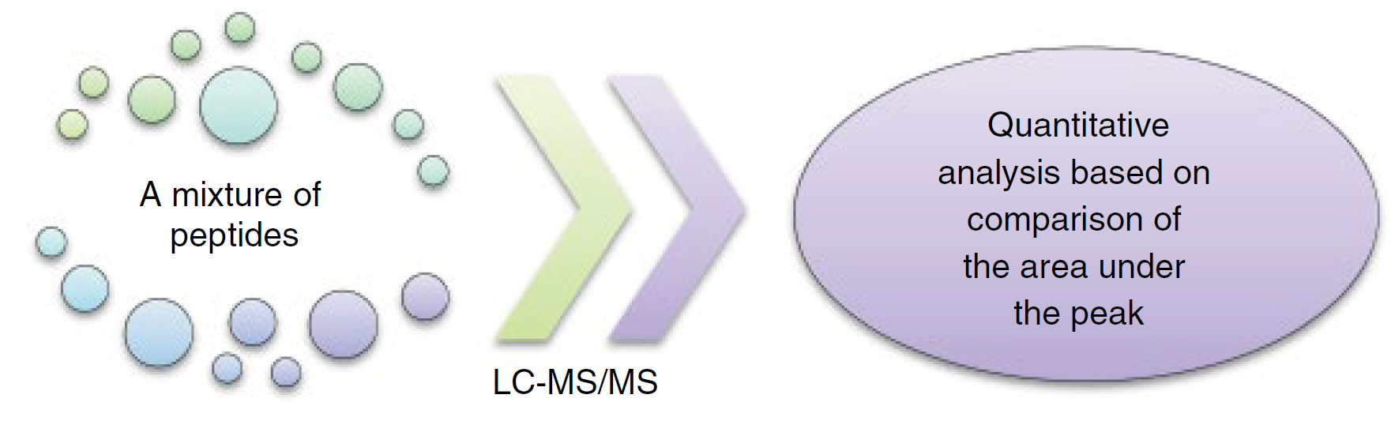
Label‐free scheme
Marek Smoluch, Giuseppe Grasso, Piotr Suder, and Jerzy Silberring, Mass Spectrometry An Applied Approach, Wiley, 2019.

Slide 105
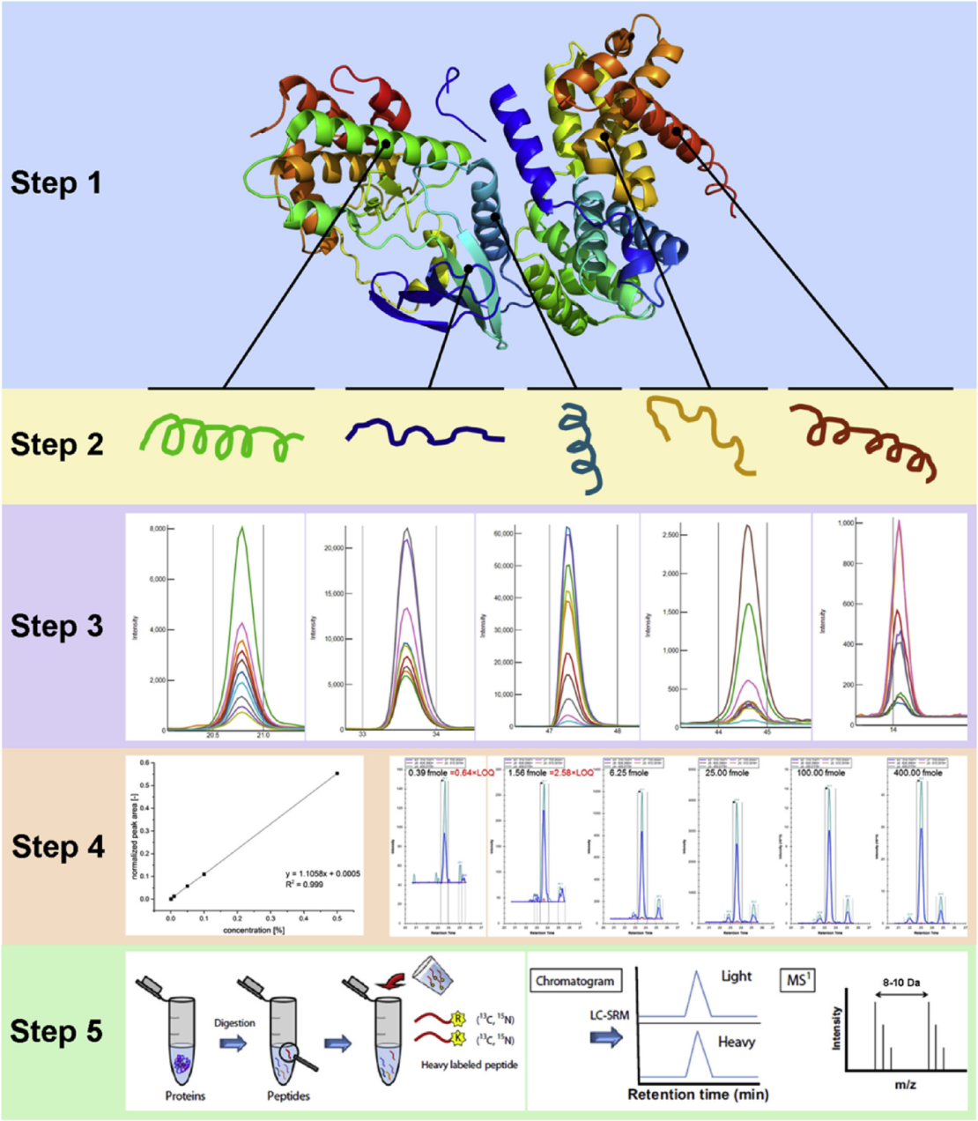
Overview of quantitative SRM assay development in targeted proteomics:
Step 1: Targeted protein is annotated using a unique identifier - accession number (i.e. UniProtKB, neXtprot, Ensembl) including all relevant proteoforms (i.e. isoforms, SNPs or PTMs).
Step 2: Proteotypic peptides are selected based on biological specificity and detectability by MS.
Step 3: SRM transitions are selected to uniquely identify a specific peptide in a given background proteome.
Step 4: Quantitative measures of an SRM assay are determined.
Step 5: Quantitative SRM assay deployment to biological or clinical samples.

Slide 106
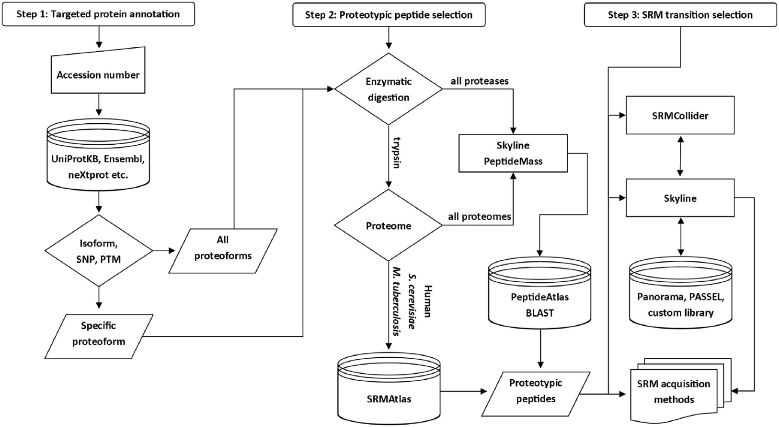
Flowchart providing step-by-step guidance on design of SRM assay (qualitative profiling). Steps 1-3 involve selection of protein targets, their proteotypic peptides and corresponding SRM transitions.

Slide 107
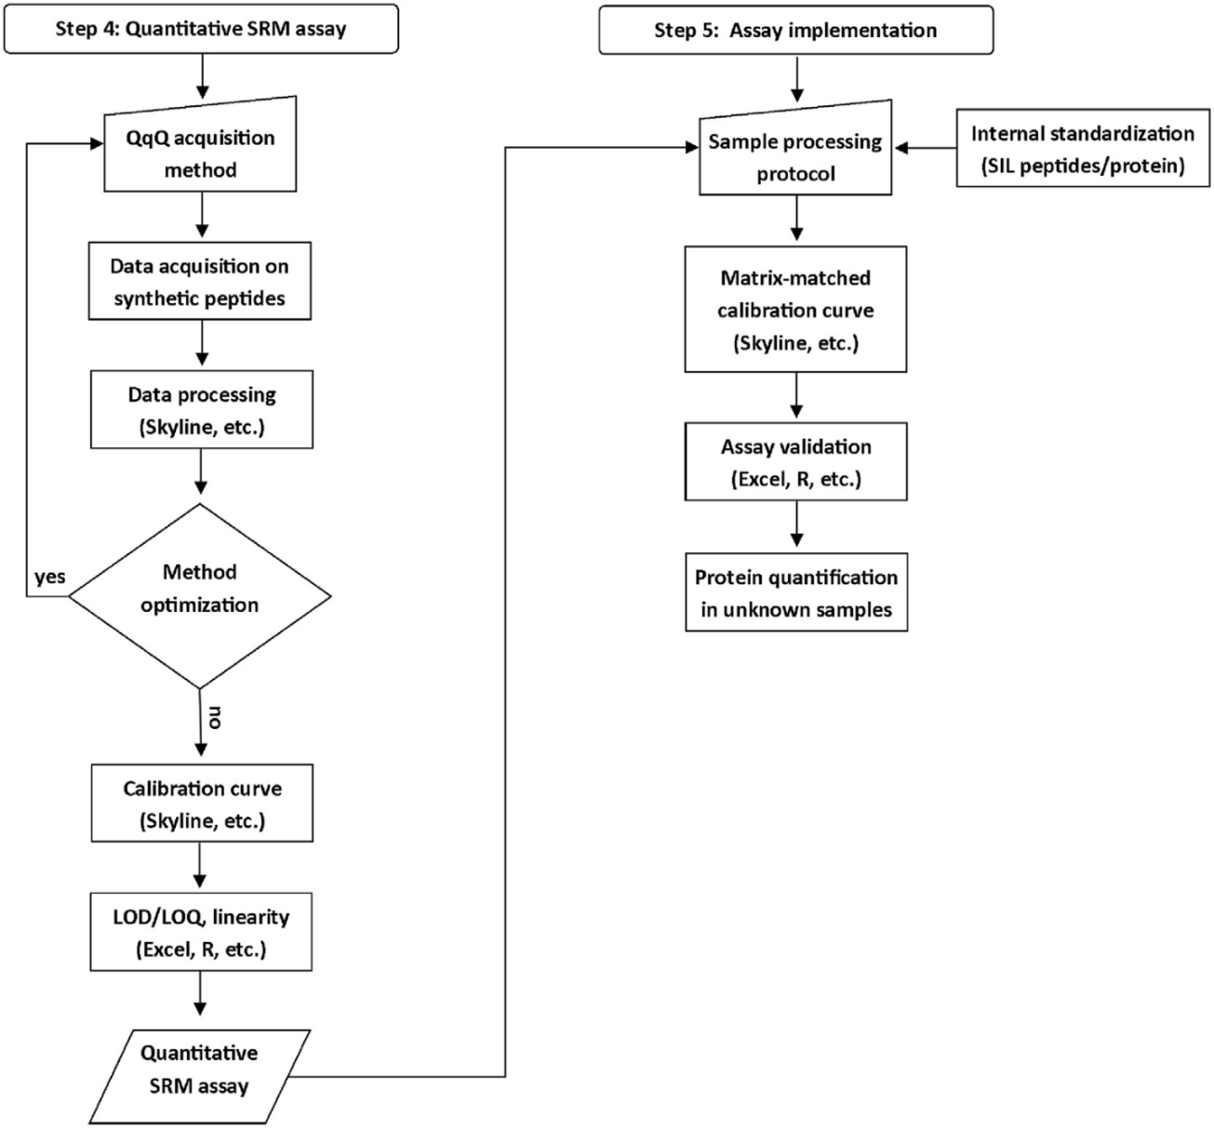
Flowchart providing step-by-step guidance on SRM assay quantitative performance evaluation and implementation. (quantitative profiling and protein assay validation). Steps 4e5 involve optimization of instrument acquisition methods, determination of quantitative measures (i.e. LOD-LOQ, linearity range) and implementation of quantitative assay in biological or clinical samples to determine assay range and to quantify unknown samples.

Slide 108
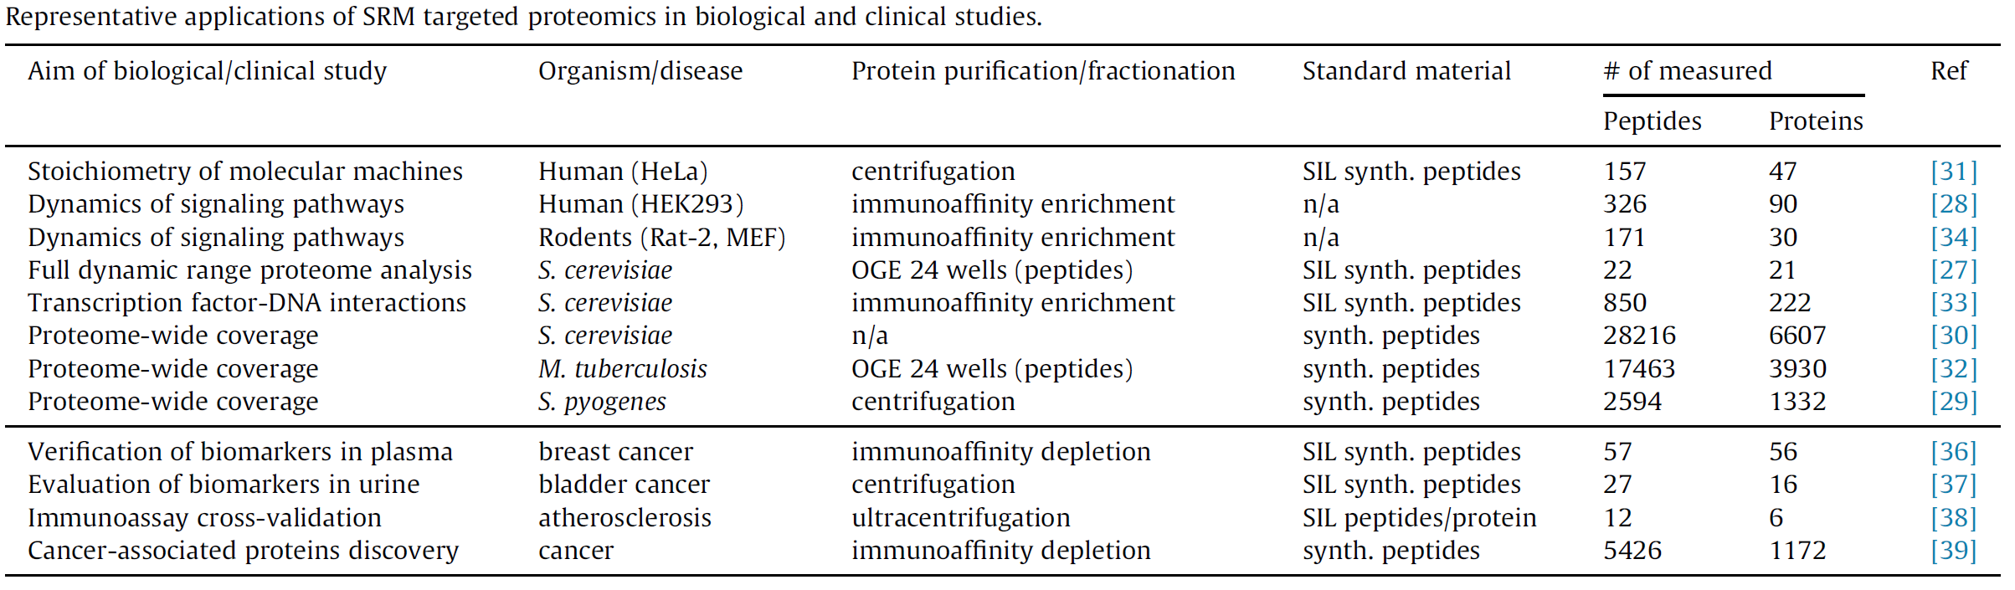
V. Vidova, Z. Spacil, Analytica Chimica Acta 964 (2017) 7-23.

Slide 109
One of the disadvantages of quantifying peptides by comparing their signal intensities is that such analysis often encompasses experimental changes (retention times of individual peptides must be very reproducible between runs). The signal‐to‐noise ratio that can affect sensitivity is also an important aspect.
Stable parameters are necessary to minimize changes during the elution time of the same peptide between subsequent analytical repeats. High quality and resolution as well as accuracy are also parameters that contribute to the overall success of quantitative proteomic experiments using the label free technique. Increasing the number of repetitions, usually around three, can allow accurate comparisons if all analytical steps related to sample preparation and system stability are reproducible. Elevated background, noise coming from the samples and reagents, may further aggravate the result of protein identification and quantitative analysis. Another issue to be considered is coelution of peptides, which always accompanies the analysis of complex biological samples [1].

Slide 110
Currently, there are many statistical tools available to analyze data obtained from multiple LC‐MS experiments, which allow to reduce the differences between successive repeats (runs), such as the following:
●● Progenesis LC‐MS (Nonlinear Dynamics, Durham, NC, USA, www.nonlinear.com)
●● ProteinLynx (Waters, Milford, MA, USA, http://www.waters.com/waters/ en_PL/ProteinLynx‐Global‐SERVER‐%28PLGS%29/nav.htm?cid=513821& locale=en_PL)
●● Elucidator (Rosetta Inpharmatics, Seattle, Washington, USA, www.rosettabio.com)
●● Decider MS (GE Healthcare, Piscataway, NJ, USA)
●● SIEVE (Thermo Fischer Scientific, San Jose, California, USA, https://www. portal.thermo‐brims.com/index.php?ct=sub&id=69)

Slide 111
Protein assays by selected reaction monitoring (SRM)
The targeted MS/MS technique of selected reaction monitoring (SRM, sometimes referred to as multiple reaction monitoring, MRM), was implemented in proteomics to enable reproducible, sensitive and selective protein assays [9,26].
In comparison to immunoassays the SRM technique features fast assay development and deployment and it is in principle capable of distinguishing highly similar proteoforms such as isoforms, post-translationally modified proteins and genetic variants such as single nucleotide polymorphism (SNPs) [9].
Veronika Vidova, Zdenek Spacil, Analytica Chimica Acta 964 (2017) 7-23.

Slide 112
For instance a typical nano-LC chromatographic peak (20e30 s FWHM) has to be recorded at acquisition rate of >0.4 Hz for reliable quantification (12e15 data points per peak). Since QqQ device requires only 0.8e10 ms per transition in SRM mode (dwell time), up to 1250 transitions are reproducibly acquired within SRM duty cycle for the given peak width. However, UHPLC quickly becomes a norm in separation science given its advantages. The technique produces narrower peaks (3e4s FWHM) due to higher separation efficiency. Thus faster acquisition rates up to 5 Hz are required when using UHPLC. In that case SRM transitions can be scheduled for a time segment corresponding to the expected LC retention time (RT) of a peptide to further improve multiplexing capabilities of protein assay. The acquisition mode is referred to as scheduled or dynamic SRM. Additionally, a set of primary SRM transitions may be predefined to trigger a set of secondary (datadependent) SRM transitions or a full MS/MS survey scan upon a particular intensity threshold. The technique is often called triggered SRM, SRM-triggered MS/MS or MRM-initiated detection and sequencing (MIDAS). In order to generate a scheduled SRM list, a peptide RT has to be derived from previous experiments or predicted using tools such as SSRCalc. Overall duty cycle efficiency is vastly improved in scheduled SRM mode, which allows for simultaneous quantitative analysis of minimally 250 peptides in a single SRM experiment.

Slide 113
Triple quadrupole mass analyzer: advantages and limitations
The main advantages of QqQ mass analyzer utilization in SRM proteomics include:
i) high sequence-based selectivity of MS/MS,
ii) rapid duty cycle compatible with modern, highly efficient liquid chromatography (LC) separation techniques (i.e. ultra-high performance liquid chromatography - UHPLC),
iii) sensitivity of QqQ device unparalleled by any other type of mass analyzer to date,
iv) straightforward data processing with minimal requirements for storage space and computational power (see Table 1).
Typical isolation window applied to the Q1 filter varies between 0.7 and 1.2 m/z, while the Q3 filter usually operates at “unit” resolution (0.7 m/z). However, some commercially available QqQ instruments allow for isolation window as narrow as 0.2 m/z. The principle of fixed isolation windows on Q1 and Q3 allows for effective duty cycle as compared to scanning over an m/z range (typically 400-1200).

Slide 114
The amount of energy supplied to a peptide ion before CID fragmentation is termed the collision energy (CE). It is optimizable with respect to a precursor (peptide) m/z or a specific transition to achieve maximal response (sensitivity). CEs are typically determined using a training set of peptide ions to derive an instrument vendor-specific linear equations or a range of CEs is tested experimentally on synthetic peptides e.g. dataset publicly available through SRMAtlas (www.srmatlas.org).

Slide 115
(A) SRM transmits a 0.7-1.2 m/z precursor isolation window through the first-stage quadrupole filter, subjects an isolated precursor to collision induced activation and transmits a 0.7 m/z product isolation window through the second-stage quadrupole filter to the detector; (B) Product Ion Scan can be acquired in DDA as well as in DIA workflow, similarly to SRM transmits a 0.7-1.2 m/z precursor isolation window through the first-stage quadrupole filter, subjects an isolated precursor to collision induced activation, but subsequently detects all product ions. (C) Parallel reaction monitoring (PRM) transmits a 1.4-2.0 m/z precursor isolation window(s) through the first-stage quadrupole filter, subjects an isolated precursor(s) to collision induced activation and transmits all product ions derived from all precursors to the detector; (D) DIA methods transmit either sequentially (through the first-stage quadrupole filter, subject isolated precursors to collision induced activation and transmit all product ions derived from all precursors to the detector.

Slide 116
